Slide 1
Indicator 13 Corrective Action Plan Training Resource
If you are utilizing this as a resource to provide training to your staff in the areas of Indicator 13 that require corrective action, please follow these steps:
Step 1: Make a copy of the slide deck
Step 2: Use Slides 4-9 as introduction for all trainings and slides 68-71 as the ending for all trainings
Step 3: Select which questions from Indicator 13 are part of your CAP and use those sections from this presentation (refer to slide 2’s Table of Contents)
*Please reach out to your regional transition facilitator if you would like additional training in the area of transition. (regional facilitators contact information can be found at the end of this slide deck)*

Slide 2
Table of Contents
Slides 4-9: Introduction Slides to Indicator 13 and Transition Planning (recommended to use for all trainings)
Slides 10-18: Indicator 13, Question 1; NDE Data Collection (ILCD) Question 10
Slides 19-23: Indicator 13, Question 2; NDE Data Collection (ILCD) Question 12
Slides 24-29: Indicator 13, Question 3; NDE Data Collection (ILCD) Questions 8,9, 11
Slides 30-39: Indicator 13, Question 4; NDE Data Collection (ILCD) Question 14
Slides 40-48: Indicator 13, Question 5; NDE Data Collection (ILCD) Question 15
Slides 49-55: Indicator 13, Question 6; NDE Data Collection (ILCD) Question 13
Slides 56-59: Indicator 13, Question 7; NDE Data Collection (ILCD) Question 6
Slides 60-67: Indicator 13, Question 8; NDE Data Collection (ILCD) Question 7
Slides 68-71: Indicator 13 Final Resources (recommended to use for all trainings)
**Notice there are not slides for NDE Data Collection (ILCD) Questions 1-5, as those questions are specific to demographics of each file that was submitted by your district**

Slide 3
Disclaimer:
This is guidance. You must submit the slides to NDE through your assigned monitor for approval to ensure it meets all of the requirements for your specific Corrective Action Plan as related to Indicator 13.

Slide 4
2025
Indicator 13
Training Support of Corrective Action Plans in the Area of Transition Planning

Slide 5
Indicator 13 CAP Training Objectives
Objective 1: Individuals will understand what Indicator 13 is and how it connects to Student IEPs in the area of transition planning
Objective 2: Individuals will understand the components of creating a meaningful transition plan for students with IEPs that are age 14 or older
Objective 3: Individuals will be given explicit instruction surrounding components of Indicator 13 in which their district was served corrective action planning on

Slide 6
First…… What are Federal Compliance Indicators?
Indicators are measures of compliance and effectiveness of a state’s implementation of Individuals with Disabilities Education Act (IDEA), Part B.
IDEA Part B is a federal statute which deals with individuals ages 3 through 21 years of age who are receiving special education and/or related services. Part B lists 20 indicators of effectiveness on which states collect and report data to the federal Office for Special Education Programs (OSEP).
States are required to report indicator outcomes in their State Performance Plan (SPP) and Annual Performance Report (APR) to OSEP annually and that is where Indicator 13 File Reviews were born from.

Slide 7
What does Indicator 13 Measure?
Indicator 13 refers to the percent of youth with IEPs aged 16 14 (in the state of Nebraska) and above with an IEP that includes appropriate measurable postsecondary goals that are annually updated and based upon age appropriate transition assessments, transition services, including, that will reasonably enable the student to meet those post-secondary goals, and annual IEP goals related to the student’s transition services’ needs. There also must be evidence that the student was invited to the IEP Team meeting where transition services are to be discussed and evidence that, if appropriate, a representative of any participating agency was invited to the IEP Team meeting with the prior consent of the parent or student who has reached the age of majority. (20 U.S.C. 1416(a)(3)(B))

Slide 8
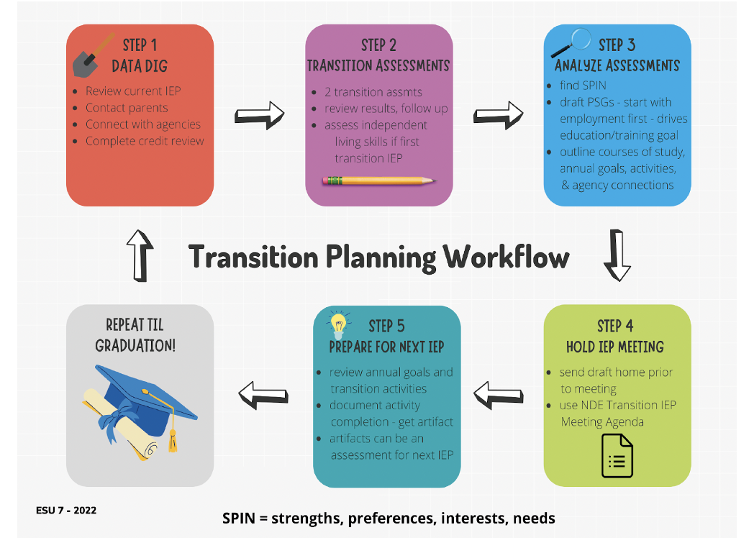
Indicator 13
=
Transition Planning,
Transition Planning
=

Slide 9
Resource for Transition Planning:
The Indicator 13 Checklist (this will be referred to throughout the training)
Are there appropriate measurable postsecondary goals for training/education, employment, and when appropriate, independent living?
Are postsecondary goals updated annually?
Is there evidence that the measurable postsecondary goals were based on age-appropriate transition assessment?
Are there transition services (activities) in the IEP that will reasonably enable the student to meet their postsecondary goals?
Do the transition services include courses of study that will reasonably enable the student to meet their postsecondary goals?
Are there annual IEP goals related to the student’s postsecondary goals/transition services needs?
Is there evidence that the student was invited to the IEP team meeting where transition services were discussed?
If appropriate, is there evidence that a representative of any participating agency was invited to the IEP meeting with the prior consent of the parent?
If any of these items are not clear on the IEP Paperwork, then you could be found out of compliance with the transition portion of your IEP.

Slide 10
Indicator 13 - Question 1
NDE Indicator 13 Data Collection Application Question 10
Appropriate Measurable Postsecondary Goals
Objective: IEP Team Members will be able to identify the components of what makes up an appropriate measurable postsecondary goal

Slide 11
Indicator 13 Checklist, Question 1; Rule References
92 NAC 51-007.07A9:
Beginning not later than the first IEP to be in effect when the child turns 14, or younger if deemed appropriate by the IEP team, and updated annually thereafter:
51-007.07A9a: Appropriate measurable postsecondary goals based upon age-appropriate transition assessments related to training, education, employment, and when appropriate, independent living skills.

Slide 12
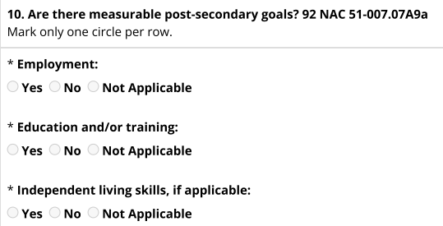
Indicator 13 Checklist, Question 1; Student Data Collection Application
(What NDE required to be answered for each file review)
You cannot select N/A for Employment or Education PSG’s when a student is at the age to have a transition plan
Evidence Submitted:
Copy of IEP

Slide 13
Indicator 13 Checklist, Question 1; Appropriate Measurable Postsecondary Goals
Is there an appropriate measurable postsecondary goal or goals in the areas of Training, Education, Employment, and Independent Living Skills (when appropriate)?
Questions to ask yourself as you are creating your IEPs:
Can the goals be counted?
Will the goals occur after the student graduates from school?
Based on the information available about this student, does (do) the postsecondary goal(s) seem appropriate for this student?
If yes to all three guiding questions above, then you have met Question 1 of Indicator 13’s checklist

Slide 14
Indicator 13, Question 1
(Postsecondary Goals - focus on the POST part of postsecondary)
Postsecondary goals (PSGs) specify the student’s plans for life after high school. They reflect the student’s current thinking and may change over time as the student gets closer to graduation.
Note: Student’s PSGs should change over time, if appropriate transition activities/services are provided, as services and activities will help the student refine their goals for life after high school
Ensure goals are set for after graduation - these cannot be written as activities to meet Postsecondary Goals; these are the actual goal that the student hopes to be able to meet after graduation
Tip: To ensure you are post-graduation focused with the goal; start all PSGs with the statement “After graduation, Student will…..”
PSGs are outcomes AFTER high school!

Slide 15
Indicator 13, Question 1
(Writing Compliant PSGs)
Ensure goals are formulated using data from Age Appropriate Transition Assessments that have been completed by or for the student prior to the annual IEP Meeting
Goal is clear and measurable
Avoid words like wants to, would like, etc
The outcome must be stated as an end result
Example: After graduation, I will enlist in the Army.
Example: After graduation, I will live in my own apartment.
Example: After graduation, I will work part time at HyVee.
If an independent living PSG isn’t needed, ensure there is evidence and/or data documented to support that in the postsecondary transition present level of performance

Slide 16
Indicator 13, Question 1
(Purpose of PSGs)
PSGs are written for 1 year after graduation.
Are you:
Preparing them to become an electrical engineer, or
Preparing them to take college coursework?
Answer: (b) preparing them to take college coursework

Slide 17
Indicator 13, Question 1
(Possible PSG Examples)
Post-secondary goals - more broad for 7th - 10th graders:
Upon graduation, I will attend a community college
Upon graduation, I will work part time
Upon graduation, I will live with my parents
PSGs - refined as students age - include location & activity
Upon graduation, I will attend CCC-Columbus and obtain a degree to become a welder
Upon graduation, I will continue my part-time job at Wendy’s
Upon graduation, I will live in the dorm at Central Community College - Columbus with a friend from high school
Upon graduation, I will attend UNO and major in a social service field
Upon graduation, I will volunteer at Project Harmony in the field of Social Work
Upon graduation, I will enroll in a computer technology training program

Slide 18
Indicator 13, Question 1
(Possible PSG Examples)
Education/Training Examples
Following exit from 18-21 years transition services, Maxine will train/exercise in her home, with the support from a physical therapist and/or caregiver, to build physical strength and stamina in order to better assist with transfers while in the home and in her community (vehicle transfers).
Employment
Following exit from 18-21 year old transition services, Maxine will work in her home by using her direct access switch on a timed setting to turn on the blender to prepare her meal that will be fed to her by her caregiver.
Independent Living Skills
After completing school district services, Cooper will live with family members and complete daily living skills as independently as possible, such as making choices about his leisure time activities, doing household chores, preparing small meals and snacks
Following exit from 18-21-year-old transition services, Maxine will live at home with her parents and support from her in-home personal care attendant.
After graduation, Kevin will continue to live with his parents and will participate in his daily care routines to the maximum extent possible.
Following high school completion, Kevin will participate in 1- 2 age-appropriate community and individual community-based activities per week related to horticulture, socialization with young adults, animals, and music.
After exiting 18-21 services, Kevin will effectively utilize an augmentative communication device at home and in the community that allows familiar and unfamiliar individuals to communicate his regarding needs, wants, and desires.

Slide 19
Indicator 13 - Question 2
NDE Indicator 13 Data Collection Application Question 12
Are postsecondary goals updated annually?
Objective: IEP Team Members will be able to put into action the steps necessary to review, revise, refine, and/or create annual postsecondary goals

Slide 20
Indicator 13 Checklist, Question 2; Rule References
92 NAC 51-007.07A9:
Beginning not later than the first IEP to be in effect when the child turns 14, or younger if deemed appropriate by the IEP team, and updated annually thereafter:
51-007.07A9a: Appropriate measurable postsecondary goals based upon age-appropriate transition assessments related to training, education, employment, and when appropriate, independent living skills.

Slide 21
Indicator 13 Checklist, Question 2; Student Data Collection Application
(What NDE required to be answered for each file review)
Evidence Submitted:
Copy of IEP

Slide 22
Indicator 13 Checklist, Question 2; Are the Postsecondary goals updated annually?
Every year, the IEP team considers three options:
After engaging in transition activities/services outlined in current IEP and completing new transition assessments, student’s PSGs are newly developed (first transition IEP or heading down completely new path from previous PSG)
After engaging in transition activities/services outlined in current IEP and completing new transition assessments, student’s PSGs are staying the same.
After engaging in transition activities/services outlined in current IEP and completing new transition assessments, student’s PSGs will be revised (similar to previous PSG with minor adjustments).

Slide 23
Indicator 13, Question 2
(Additional reminders and Tips)
For Annual IEPs……. Ensure you are utilizing current data and current results from annual transition assessments to develop Post Secondary Goals.
It is OKAY to have PSGs stay the same, as long as data and transition assessments continue to align with those goals
ALWAYS review PSGs at each IEP meeting, even if they are remaining the same
If Assessments or current data indicate a revision or refinement of annual PSGs, that is OKAY - update the goals and review as a team at the IEP meeting

Slide 24
Indicator 13 - Question 3
NDE Indicator 13 Data Collection Application Question 8, 9, 11
Is there evidence that the measurable postsecondary goal(s) were based on age appropriate transition assessment?
Objective: IEP Team Members will be able to utilize multiple transition assessments that are conducted annually for each student on an IEP, age 14 and up, to create meaningful student driven measurable postsecondary goals

Slide 25
Indicator 13 Checklist, Question 3; Rule References
92 NAC 51-007.07A9:
Beginning not later than the first IEP to be in effect when the child turns 14, or younger if deemed appropriate by the IEP team, and updated annually thereafter:
51-007.07A9a: Appropriate measurable postsecondary goals based upon age-appropriate transition assessments related to training, education, employment, and when appropriate, independent living skills.

Slide 26
Indicator 13 Checklist, Question 3; Student Data Collection Application
(What NDE required to be answered for each file review)
Evidence Submitted:
Copy of IEP

Slide 27
Indicator 13 Checklist, Question 3; Is there evidence PSG’s were based on age-appropriate transition assessment?
Age-appropriate transition assessments are the foundation of EVERY transition IEP.
Transition Assessment Reminders:
Transition Assessments must be completed annually
A minimum of Two Assessments must be completed annually
Assessments should be chosen to match each student’s individual needs
Do not use the same assessments year after year

Slide 28
Indicator 13, Question 3 (how to document the evidence)
There are several places to look to ensure that data from transition assessments were used to develop the students PSGs
The most common area to note this, is in the transition section of your IEP that requires the summary of findings from the current and age-appropriate transition assessments
Two Assessments must have been administered within one year of the IEP effective date
Ensure the name of the transition assessment that you utilize is clearly identified, as well as the individual that completed the transition assessment (i.e. student, teacher, parent, etc.)
If a student does not need an Independent Living PSG, state it in the summary of assessment findings section or in the section that you list the transition assessments
Example Statement: The transition assessment completed was an independent living skill assessment. The student, parents, & Special educator each completed an assessment, and data from each protocol was compiled and considered for transition planning. At this time, the IEP team has determined that ‘student’ does not need an independent living PSG.
Why does this need to be explicitly stated?
This is specifically asked on the ILCD file review - if not provided, there is not proof this is not needed

Slide 29
Indicator 13, Question 3
(the importance of transition assessments to PSGs)
Transition assessments lead to the development of postsecondary goals, courses of study, transition services/activities, annual goals and instruction, agency linkages, and, well, the whole IEP.

Slide 30
Indicator 13 - Question 4
NDE Indicator 13 Data Collection Application Question 14
Are there transition services in the IEP that will reasonably enable the student to meet his or her postsecondary goal(s)?
Objective: IEP Team Members will be able to identify transition services and activities that will reasonably enable students to meet their postsecondary goals, as well as which adult is the appropriate individual to ensure such activity occurs during the current IEP

Slide 31
Indicator 13 Checklist, Question 4; Rule References
92 NAC 51-007.07A9:
Beginning not later than the first IEP to be in effect when the child turns 14, or younger if deemed appropriate by the IEP team, and updated annually thereafter:
51-007.07A9a: Appropriate measurable postsecondary goals based upon age-appropriate transition assessments related to training, education, employment, and when appropriate, independent living skills.

Slide 32
Indicator 13 Checklist, Question 4; Student Data Collection Application
(What NDE required to be answered for each file review)
Employment - not applicable is NOT an option
Education and/or training - not applicable is NOT an option
These two postsecondary goals must be written for EVERY transition-age student with an IEP, period.
Evidence Submitted:
Copy of IEP

Slide 33
Indicator 13, Question 4;
Important Reference: Transition Services as outlined in IDEA 300.43
Transition services means a coordinated set of activities for a child with a disability that is
designed to be within a results-oriented process
focused on improving the academic AND functional achievement
facilitates movement from school to post-school activities
includes postsecondary education, vocational education, integrated employment (including supported employment), continuing and adult education, adult services, independent living, and/or community participation
Transition Services are based on the individual child’s needs, taking into account the child’s strengths, preferences, and interests, and includes:
instruction
related services
community experiences
development of employment & other post-school adult living objectives
if appropriate, acquisition of daily living skills & functional vocational evaluation
Transition services for children with disabilities may be special education, if provided as specially designed instruction, or a related service, if required to assist a child with a disability to benefit from special education.

Slide 34
Indicator 13 Checklist, Question 4; Are there transition services (activities) in the IEP that will reasonably enable the student to meet their postsecondary goals?
Once the IEP team has considered the assessment results and developed the post-secondary goals, the team must determine the services/activities that will be provided to help the student move towards attaining the PSGs.
Activities are one-time or short-term events
Activities and Services listed on the IEP should be completed during timeframe of the current IEP
There should be at least one activity or service listed for each PSG

Slide 35
Possible Resource: Examples of Transition Services/Coordinated Set of Activities
Indicator 13, Question 4
(Planning Activities and/or Services)
When planning annual activities and services for each student, some guiding questions for the team to review could include:
What experiences or opportunities should the student have during this IEP year that move them toward achieving their post-secondary goals?
Do we know enough about the student’s vocational skills to design activities to support the identified goal? Do we need to consider work-based learning?

Slide 36
Indicator 13, Question 4
(What is the true purpose behind these activities or services?)
Activities are intended for the student to make progress towards achieving their postsecondary goals (PSGs).
This is where students learn about what it takes to move their goals from dreams to reality.
Example: It’s OK for a 14 year old that’s never played football to have an employment PSG of playing football in the NFL. The activities will then be focused on understanding the steps of becoming an NFL football player - moving future PSGs towards more realistic targets.

Slide 37
Indicator 13, Question 4
(Requirements to indicate transition services and activities on the IEP)
Provide a description of the service or activity that will be completed
Provide the title and agency of the responsible adult to ensure the activity or service occurs - note, this must be an adult
The district must ensure ALL transition activities are completed by the next annual IEP (it cannot be an activity that will be completed in 2 or 3 or 7 years)
Each activity must be linked to at least one PSG (it could align with two or three and that’s okay)
You must have a minimum of 2 transition services/activities per student

Slide 38
Indicator 13, Question 4
(Which adult should be listed as the individual responsible for ensuring transition activities occur?)
*It should not always be the IEP Case Manager* Any adult can assist the student in completing transition activities, but they must be adult-led, meaning the adult gets the student rolling and supports the completion of the activity
Example: If a student is interested in joining the army after high school and the school counselor is the link to the army recruiter for all students; then the school counselor can (and should) be the one helping the student connect to the recruiters - you would list the school counselor as the adult who is responsible for this activity
Think about using activities as a way for students to find the natural connection to a resource. (this is something we need to be able to do as adults, so we need to teach it now)

Slide 39
Indicator 13, Question 4
(Evidence Tips for Activities and Services)
Capture transition activities with an artifact
Demonstrate student completed activity
Conduct ongoing transition assessment
Help student make progress toward PSGs
Discuss results-make magic happen!
Idea: duplicate present IEP after it’s finalized, and start capturing activities as they happen
Another idea: upload all artifacts (informal transition assessments) as one notes page to document the completion of the year’s transition activities

Slide 40
Indicator 13 - Question 5
NDE Indicator 13 Data Collection Application Question 15
Do the transition services include courses of study that will reasonably enable the student to meet his or her postsecondary goal(s)?
Objective: IEP Team Members will be able to outline detailed courses of studies for their students age 14 and above from the date of the IEP through their expected graduation date

Slide 41
Indicator 13 Checklist, Question 5; Rule References
92 NAC 51-007.07A9:
Beginning not later than the first IEP to be in effect when the child turns 14, or younger if deemed appropriate by the IEP team, and updated annually thereafter:
51-007.07A9b: The transition services (including courses of study) needed to assist the child in reaching those goals;

Slide 42
Indicator 13 Checklist, Question 5; Student Data Collection Application
(What NDE required to be answered for each file review)
Evidence Submitted:
Copy of IEP

Slide 43
Indicator 13, Question 5; Do the transition services include courses of study that will reasonably enable the student to meet their postsecondary goals?
Courses of study outline exact academic and functional performance requirements the student must complete to accomplish their PSGs, meet graduation requirements, and prepare for adulthood.
Multi-year description of coursework from today until graduation or the student exits at age 21 - required courses and electives
List specific courses by title for each year
Specify how courses help student meet their PSGs
Review and update annually
Transition PLEP: student passed courses, drop course, class was not available, etc.

Slide 44
Indicator 13, Question 5; Course of Study Examples and Non Examples
Example: (include the official course names)
8th Grade:
Science, Social Studies, English, Band, Reading, Art, Band, PE, Choir
9th Grade:
English 1, Algebra 1, Physical Science, PE, American History, Art, Band
10th Grade:
English 2, Geometry, Biology, Personal Finance, Western Civ, Weights, Band
11th Grade:
English 3, Algebra 2, Applied Science, Computer Tech, Industrial Tech, Band, Welding
12th Grade:
English 4, Technical Math, Civics, Small Engines, Drafting, Electronics, Band
Reminders
If a course is not a general education course, narrative must be provided that describes WHAT will be taught
You must include current year’s courses and all years following until expected graduation
Non Example: Student is enrolled in the classes needed to graduate. Student is taking elective courses they find interesting.

Slide 45
Indicator 13, Question 5; Course of Study Examples for Students that will continue through age 21
If the student is staying past their cohort’s senior year and attending school until age 21, you must write the course of study to reflect the academic AND functional performance skills that will be taught each year, example below:
Year 1 of 18-21 programming:
personal preferences class, meal prep and cooking class, community safety class, life skills math and reading classes
Year 2 of 18-21 programming:
self-advocacy class, social skills class, interpersonal relationships class, life skills math and reading classes
Year 3 of 18-21 programming
personal finance class, home safety class, community living class, emergency first aid class, life skills math and reading classes

Slide 46
Indicator 13, Question 5; Course of Study Description Examples
'Student' is a freshman at Paradise High School. Presently, he is enrolled in the following classes: English 1, Algebra 1, Physical Science, PE, American History, Art, Band
At this time, 'Student' is earning credits to graduate with his peers at the end of his senior year in May of 20XX. Because 'Student' is interested in a career in welding, the geometry and English classes he will take next year will prepare him for reading college level textbooks and blueprints, and provide math instruction beneficial for a career in welding. This coursework will also provide the foundation for earning a welding certificate and aligns with our district’s graduation requirements.
When 'Student' is a junior and senior, he will take upper level English, math, and science courses, and career/technical education classes. These courses will also prepare 'Student' for college coursework necessary for him to enter a welding certificate program at a community college.

Slide 47
Indicator 13, Question 5; Course of Study Description Examples for Students with More Significant Disabilities
Students with significant disabilities will have a different narrative here. That’s OK.
Describe the significance of their disability in a sentence or two.
Describe the life skill academics and functional performance (daily living and pre-employment skills) you anticipate them needing from now until graduation. Example below:
‘Student’ is enrolled in life skills reading, math, daily living, and pre-employment classes. ‘Student’ will work on recognizing environmental print and community signage during reading instruction. ‘Student’ will work on 1-1 object correlation (up to 6 objects) and using measuring cups/spoons during math instruction. Daily living instruction will focus on hygiene, laundry, and cooking. Pre-employment skills will be developed through completing one-step directions utilizing task boxes. The nature and severity of ‘Student’s’ disability requires hand-over hand support to complete most curriculum tasks. ‘Student’ also requires frequent breaks during the day for feeding via g-tube, personal hygiene care, and to stretch on the floor. ‘Student’ loves animals and wants to live in a community-based residential apartment after graduation, ‘Student’s’ life skill coursework is designed to maximize his independence and develop pre-employment skills to gain supported employment in a setting with animals.

Slide 48
Indicator 13, Question 5;
Additional compliance item within the realm of Course of Study
Projected Date and Description of Anticipated Graduation Program Completion Examples:
Student A is projected to graduate with their class in May of 20XX upon completion of their previously outlined course of study
Student B is projected to participate in social graduation with their class in May of 20XX and receive a certificate of attendance at the graduation ceremony. They will continue with special education services as outlined in their courses of study until Student B finishes the year in which they turn 21 years of age. Then Student B will transition to an adult service provider of their choosing, as Student B is eligible for adult services from DHHS-Developmental Disabilities
Student C is completing credit recovery and the IEP team has identified the courses and the timeline needed to graduate with Student C’s peers in May of 20XX. Student C’s plan of credit recovery is described within the courses of study section

Slide 49
Indicator 13 - Question 6
NDE Indicator 13 Data Collection Application Question 13
Is (are) there annual IEP goal(s) related to the student’s transition services needs?
Objective: IEP Team Members will be able to connect every postsecondary goal (PSGs) and it’s connecting service or activity, to at least one annual IEP goal

Slide 50
Indicator 13 Checklist, Question 6; Rule References
92 NAC 51-007.07A9:
Beginning not later than the first IEP to be in effect when the child turns 14, or younger if deemed appropriate by the IEP team, and updated annually thereafter:
51-007.07A9b: The transition services (including courses of study) needed to assist the child in reaching those goals;

Slide 51
Indicator 13 Checklist, Question 6; Student Data Collection Application
(What NDE required to be answered for each file review)
Evidence Submitted:
Copy of IEP

Slide 52
Indicator 13, Question 6;
Is (are) there annual IEP goal(s) related to the student’s transition services needs?
Step 1: Ensure that each PSG has at least one transition service or activity linked to it within the transition plan
Step 2: Ensure each PSG is somehow linked to at least one annual IEP goal - one annual IEP goal could be linked to one, two, or all three PSGs
If Step 1 and Step 2 are done correctly then….. a transition service/activity is linked to a PSG and a PSG is linked to an Annual IEP Goal; therefore, the transition service/activity should be able to be linked to the Annual IEP Goal.

Slide 53
Indicator 13, Question 6;
How do we align Annual Goals to PSGs and their Transition Activities/Services?
Step 1: Start by thinking about the reason the student needs specialized instruction from a special education? (why are they in special education)
Step 2: Consider the minimum industry standards needed to move from high school toward their postsecondary goals
Example: A student’s employment postsecondary goal requires a 4 year degree. Think about why the student needs special education supports and what skills do they still need to acquire in order to be accepted into college and be successful in college.
If the student struggles with meeting homework deadlines, there may be an annual IEP goal that supports executive functioning skills with organization, time management, etc. - that goal could then be linked to the employment PSG and/or education PSG since it is a necessity to meet both

Slide 54
Indicator 13, Question 6;
Additional example to think through when aligning Annual Goals to PSGs and their Transition Activities/Services?
Example: Student wants to go to college to be a teacher. The Landmark Guide to College Readiness states that student needs the below academic skills as a minimum skills set to consider a successful college experience. Can your student complete these necessary skills? If not, what activities or IEP goals could you implement to bridge that gap for your student?

Slide 55
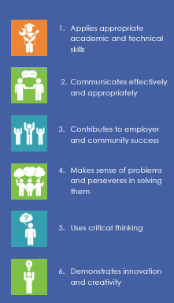
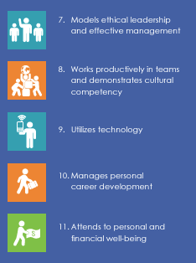
Indicator 13, Question 6;
Additional Resource to assist in aligning Annual Goals to PSGs and their Transition Activities/Services?
NDE’s Career Ready Standards
These are aligned to state standards and provides the list of skills that an individual should be able to demonstrate to show they are career ready in their selected field

Slide 56
Indicator 13 - Question 7
NDE Indicator 13 Data Collection Application Question 6
Is there evidence that the student was invited to the IEP Team meeting where transition services were discussed?
Objective: IEP Team Members will be able to identify the necessary components required to ensure each student is invited to participate in their IEP during the year in which they are turning 14 years of age or older and what evidence will support such invite

Slide 57
Indicator 13, Question 7 Checklist; Rule References
92 NAC 007.03A10
If the purpose of the meeting is to consider postsecondary goals for the child and the transition services needed to assist the child in reaching those goals:
007.03A10a The school district or approved cooperative must invite the child;
007.03A10a(1) If the child does not attend the IEP meeting, the school district or approved cooperative shall take other steps to ensure that the child’s preferences and interests are considered.

Slide 58
Indicator 13 Checklist, Question 7; Student Data Collection Application
(What NDE required to be answered for each file review)
Evidence Submitted:
Copy of Meeting Invite
Copy of IEP Signature Page

Slide 59
Indicator 13, Question 7;
Is there evidence that the student was invited to the IEP team meeting where transition services were discussed?
**Indicator 13 states we must invite the student to the IEP meeting. It does not state they must attend the meeting**
Step 1: Ensure the meeting Notice Invite includes the student as an invited participant
Step 2: Ensure prior to the IEP meeting that the student has provided their strengths, preferences, interests and needs in regards to their transition planning and that those are documented in the IEP
Step 3: If the student attends, ensure that they sign in at the meeting or that it is documented they were in attendance

Slide 60
Indicator 13 - Question 8
NDE Indicator 13 Data Collection Application Question 7
If appropriate, is there evidence that a representative of any participating agency was invited to the IEP Team meeting with the prior consent of the parent or student who has reached the age of majority?
Objective: IEP Team Members will be able to identify the steps required prior to inviting a representative of any outside agency to a student’s IEP meeting

Slide 61
Indicator 13 Checklist, Question 8; Rule References
92 NAC 007.03A10
If the purpose of the meeting is to consider postsecondary goals for the child and the transition services needed to assist the child in reaching those goals:
007.03A10b: To the extent appropriate, with the consent of the parents or a child who has reached the age of majority, the school district or approved cooperative must invite a representative of any participating agency that is likely to be responsible for providing or paying for the transition services.

Slide 62
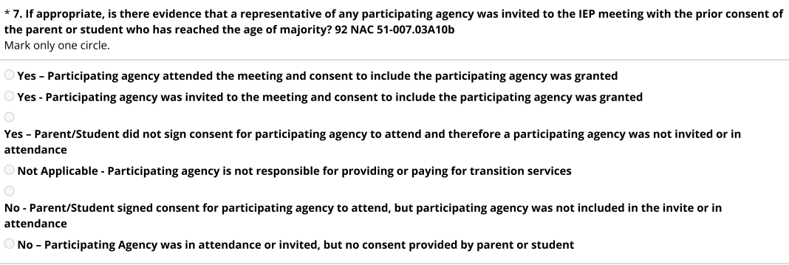
Indicator 13 Checklist, Question 8; Student Data Collection Application
(What NDE required to be answered for each file review)
Evidence Submitted:
Copy of Meeting Notice
Copy of Consent to Invite Outside Agency
Copy of IEP Signature page

Slide 63
SRS Specific Districts - Indicator 13, Question 8
If appropriate, is there evidence that a representative of any participating agency was invited to the IEP Team meeting with the prior consent of the parent or student who has reached the age of majority?
SRS is creating an update to their system…..
The Notice of Meeting and the Consent for an Outside Agency to Participate in the meeting are now two separate forms
Step 1: Send the Consent for an Outside Agency to Participate in the Meeting to parents prior to the Notice of Meeting
Step 2: Once the Consent for an Outside Agency to Participate in the Meeting is returned, send out the Notice of Meeting with the appropriate individuals listed on such notice
**This went live in 2024

Slide 64
Non-SRS Specific Districts - Indicator 13, Question 8
If appropriate, is there evidence that a representative of any participating agency was invited to the IEP Team meeting with the prior consent of the parent or student who has reached the age of majority?
Documentation must be shown to ensure parents signed off or agreed upon the involvement of an outside agency to be invited to the IEP meeting, prior to the IEP meeting.
This may be done through your district’s Notice of Meeting Document, so long as parents are acknowledging the invite of others and this is communicated to the district prior to the start of the meeting
Recommendation: to have this consent uploaded as evidence into your IEP platform for each student

Slide 65
Indicator 13, Question 8;
The what, when, and why behind further understanding the role of interagency collaboration within a student’s IEP
What is interagency collaboration?
Interagency collaboration establishes partnerships/referrals to outside agencies to achieve a common goal; to improve the post-secondary success of students with disabilities
Interagency collaboration is a means to:
Coordinate services and supports
Identify and address gaps in services within the community
Share and leverage resources to reduce costs
Promote efficient service delivery

Slide 66
Indicator 13, Question 8;
Examples of outside agencies that may be considered as possible participants in a student’s IEP, with prior consent provided by parents/guardians
Nebraska VR (Voc Rehab) and
NE Commission for Blind/Visually Impaired and Commission for Deaf/HOH
All about employment!
Refer ages 14+
NE DHHS Developmental Disabilities
Students with lifelong developmental disabilities
Refer at any age, have good data by middle school
Provide community based services
League of Human Dignity/Independent Living Centers/DHHS A&D Waiver
Support students and their families receiving Aged & Disabled Waiver
Home based support rather than community based services
PTI Nebraska - Parent Training and Information Center
Parent/Professionals
Provides supports for parents to better understand special education, specialized health and medical, and disabilities for students 0-26 years

Slide 67
Indicator 13, Question 8;
Examples descriptions of interagency linkages and responsibilities that may be outlined in your student’s IEP
Example Statements:
The student and their family have received information regarding the services and supports provided by (Nebraska VR, DHHS Developmental Disabilities, PTI Nebraska). A brochure/website/email address was given to the student and their family at the IEP.
The student and their family have received information regarding the services and supports provided by XYZ agency. At this time, the family is not interested in completing an application/connecting to this agency.
The parents signed written consent for a Nebraska VR counselor to attend this IEP meeting. The agency will provide……..
The student is receiving Aged and Disabled Waiver in their home, and their A&D services coordinator is __________.
The family is interested in completing an application to determine eligibility for Developmental Disabilities, and the district will help with the application process.

Slide 68
Indicator 13
Corrective Action Plan Training
Final Resources

Slide 69
Making Transition Planning Meaningful……..
“A truly successful transition process is the result of comprehensive team planning that is driven by the dreams, desires and abilities of youth. A transition plan provides the basic structure for preparing an individual to live, work and play in the community, as fully and independently as possible.”
-Parent Tips for Transition Planning, PACER Center

Slide 70
Resources
Reminder: If you would like additional, more in-depth training provided and/or resources, please reach out to your regional facilitator!
Indicator 13 Nebraska Toolkit
Indiana University Bloomington Center on Community Living and Careers https://www.iidc.indiana.edu/cclc/index.html
National Technical Assistance Center on Transition https://transitionta.org/
Nebraska Department of Education, Transition Planning Guidance Document. Office of Special Education, 2022
Nebraska Department of Health and Human Services - Developmental Disabilities https://dhhs.ne.gov/pages/developmental-disabilities.aspx
Nebraska VR http://www.vr.nebraska.gov
Next Steps New Hampshire https://nextsteps-nh.org/
PTI Nebraska https://pti-nebraska.org/
Transition Coalition https://transitioncoalition.org
Virginia Commonwealth University https://centerontransition.org/
Zarrow Center for Learning Enrichment https://www.ou.edu/education/centers-and-partnerships/zarrow

Slide 71
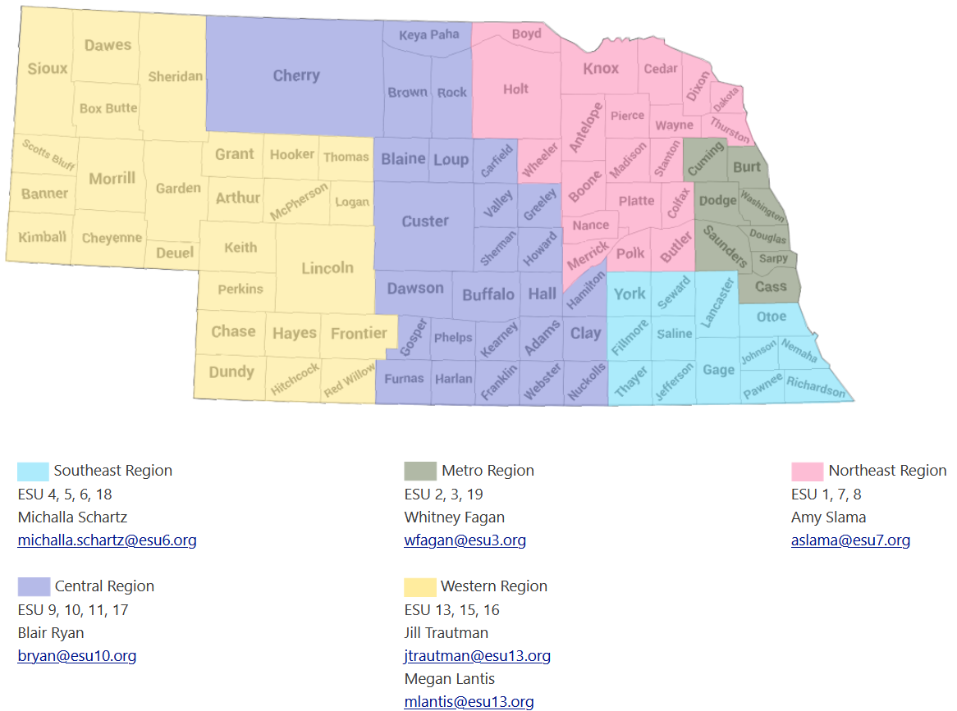
Regional Supports

