Slide 1


Talking to Your Child About Disability
Michalla Schartz, SE Region Transition Facilitator

Slide 2
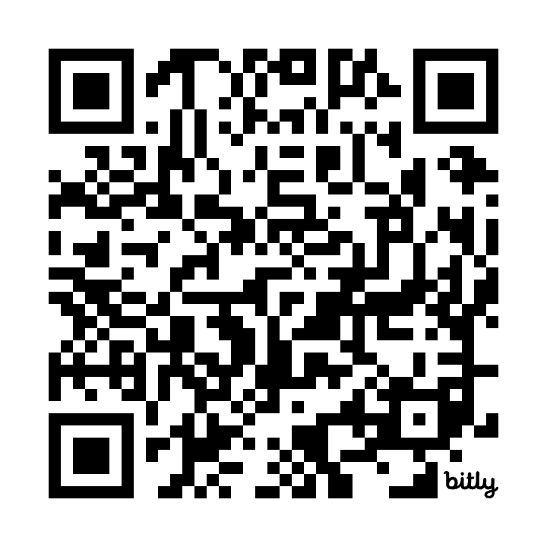
Slides for tonight
Slides in English - https://bit.ly/Talking2YourChild
Slides in Spanish -

Slide 3
Purpose of tonight’s presentation
We wanted to do an episode dedicated to empowering families who have children with disabilities and building stronger self-advocates.

Slide 4
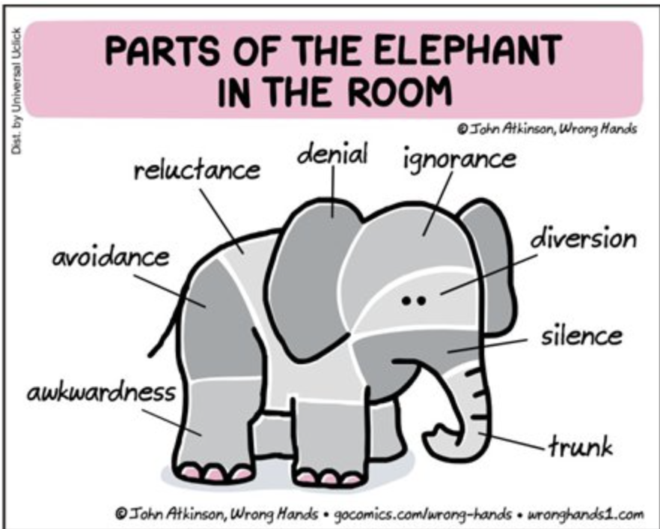
Notes:
Knowledge is power

Slide 5
When To Talk With Your Child About Their Disability
When Your Child Starts Asking Questions
They are curious.
Somebody else said something and there are feelings or experiences that must be brought up.
They are starting to have some self-awareness and realize that maybe they’re doing things differently than other kids or they can’t do the same things that their peers are doing.
Your child is leaving class to go to the “resource room” or to a pull out classroom.

Slide 6
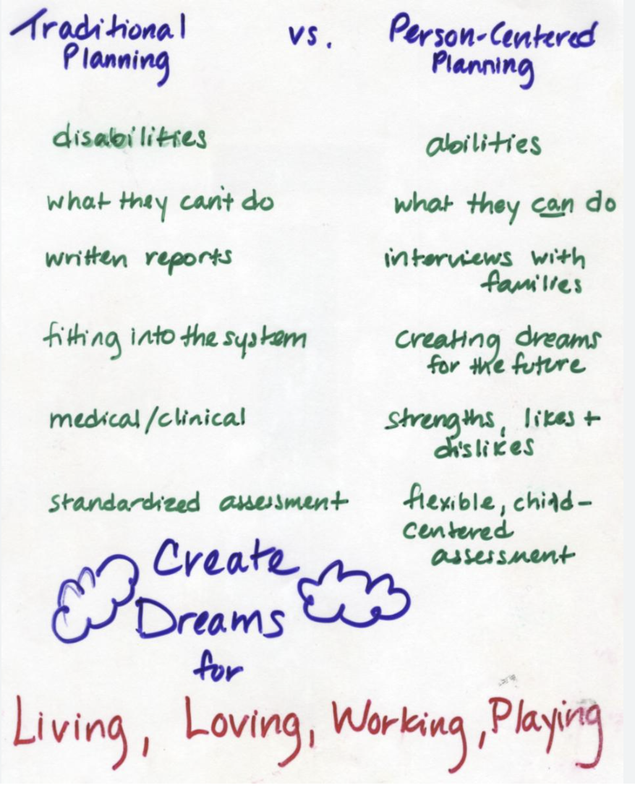
It’s not a one and done conversation
Age Changes Conversations - having a conversation when your child is 7 is going to look very different and more basic and matter of fact than when your child is 17.
Have a Plan - you should probably think about a plan for yourself because this may come up before you’re ready and if you get that question before you’re ready and you’re like “oh, uh”; that sends a message to your child like “oh did I ask something wrong”; you know like why did that startle you so you should be prepared with a plan.
Avoid Redirection - validate, communicate and be honest. If you push away and try to redirect right that’s equally problematic. Timing isn’t always great, but honesty is. It’s okay to say I don’t know, but we can look together :). Reaffirm and revisit.
Create Visuals - this can help your child keep track of and revisit. Poster paper, books, notebooks, journals, or whatever appeals to your child.

Slide 7
Ask Your Child What They Know About the Disability
It’s a good idea to to get into their minds a bit - see the perspective and experiences they are bringing to the conversation.
Use starters such as
Let’s talk about that.
What do you know about Autism or _________?
Tell me what you see/feel/do (could be describing behaviors, learning, communication or social experiences)
What have others told you about _____________?
Take the opportunity to explain what the disorder is and how it affects the way they learn, act, move or interact. Clear up any misconceptions that your child may have about the diagnosis, for example, “I’m stupid,” or “Dysgraphia or Downs or xyz will go away when I get older.”

Slide 8
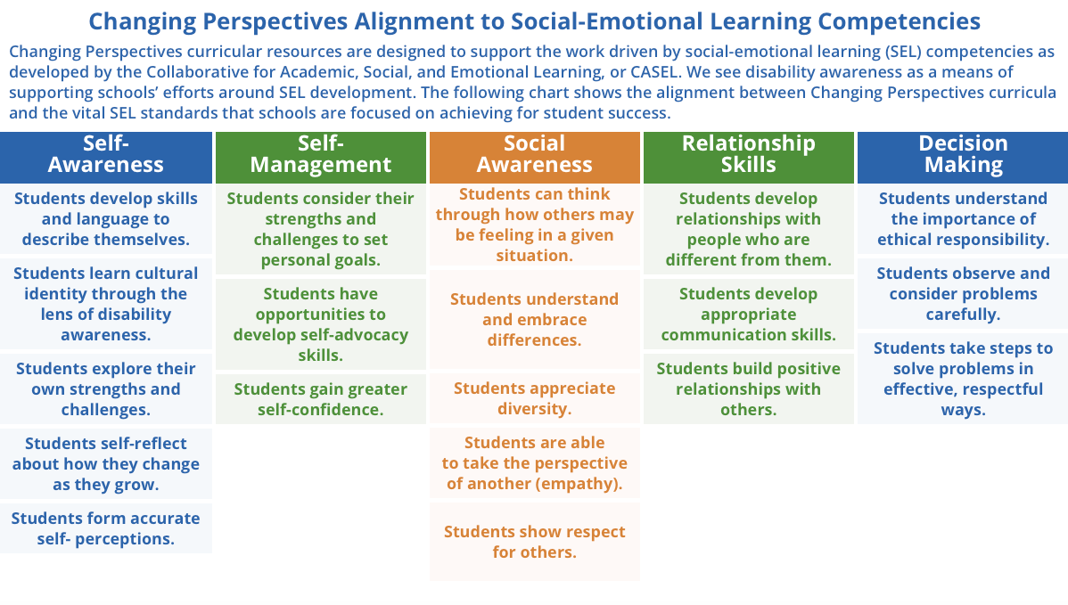
A changing perspective for Social Emotional Learning
https://changingperspectivesnow.org/social-emotional-learning/

Slide 9
Have Statements and Examples Ready
Practice some statements that you could make and have ready to go if your child is asking questions or if they’re making statements about themselves right in the moment.
Develop affirmations:
“you think differently” right? That’s not good, that’s not bad, it’s just thinking differently.
“your challenges don’t define you, everyone has strengths, everyone has challenges.”
“a disability is a difference that makes it harder for others to do something that others may be able to do easily. It’s a difference but it doesn’t mean it’s good or bad.”
“remember that time when we were….and you had to do it differently from your friends but you all had fun and laughed and played. It was different and fun.”
Think about ways to keep it age-appropriate. Your statements will need to change as your child grows and changes. I would encourage you to ask, to encourage them to ask questions as you establish yourself as a trusted partner in this journey of understanding.

Slide 10
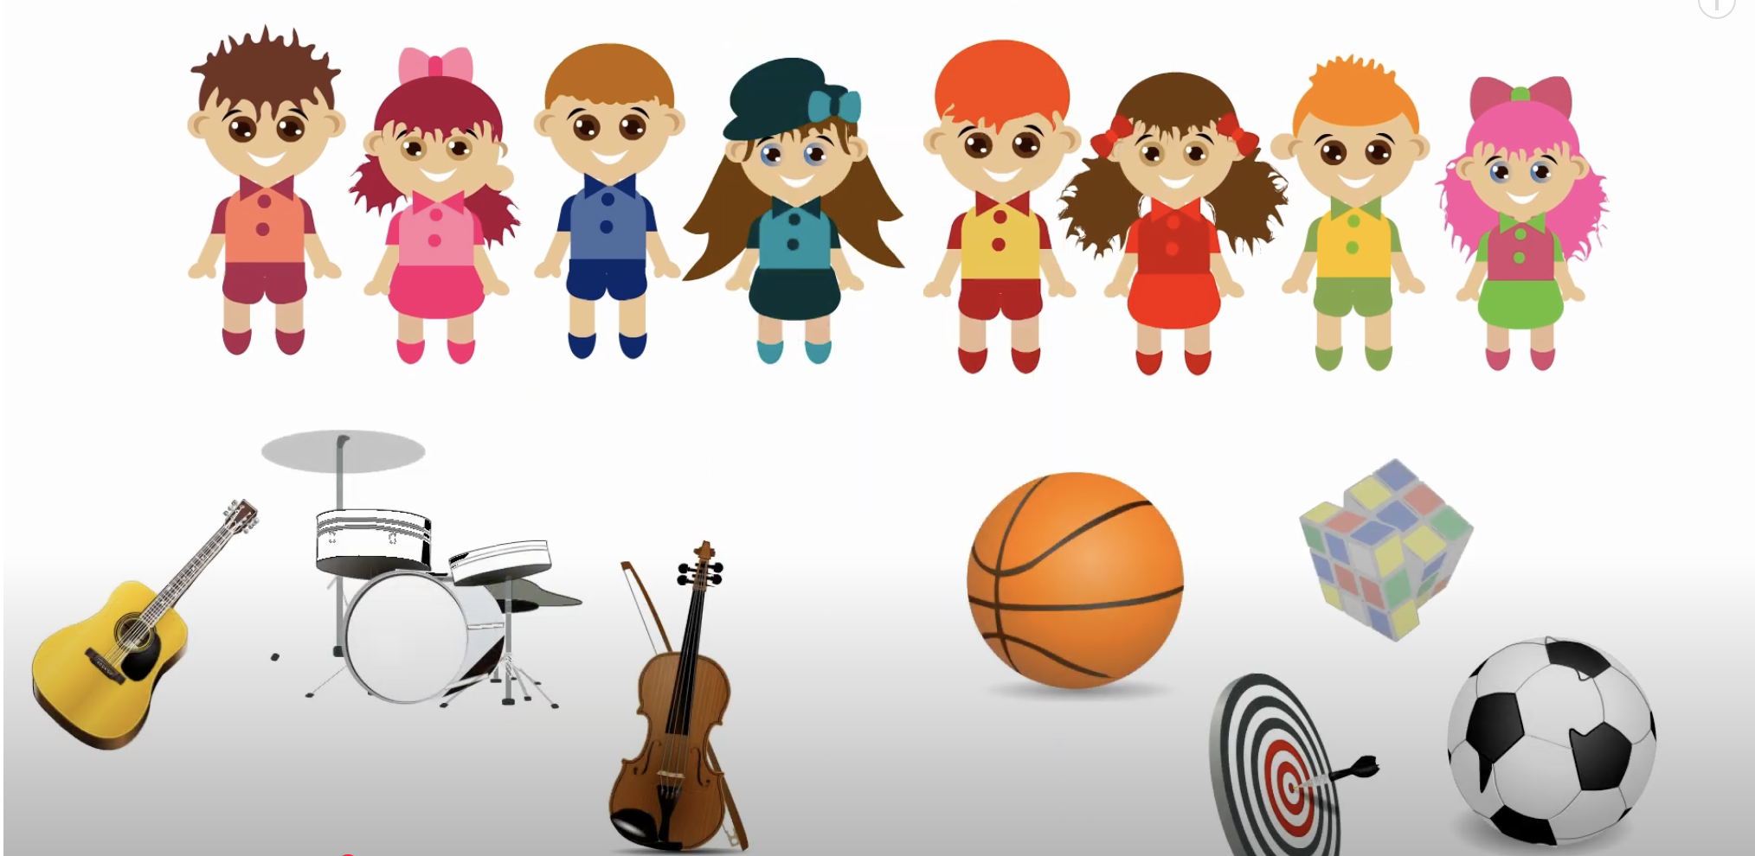
Identify What to Say to Others While Empowering Your Child
This goes along with having a plan. It’s important to identify what to say to others and it’s also important to think about empowering your child because this is the first experience they will have with advocacy. Truthful, direct and matter of fact statements can provide the roadmap for your child to follow.
Practice and roleplay this with your child. You can roleplay it in different ways and different scenarios whether it’s just a curious peer or adult in the community.
Be proactive and help your child brainstorm what they’re feeling, what they’re comfortable saying to help make it an empowering process. Give them the words.
Discuss self-disclosure and the pros/cons of sharing disability and information with others in age appropriate terms. Give them the words and power to own and share what they choose. This can help them make the best decision for them.
Think long term but don’t jump to far ahead. Live in the now, but think long term, because knowledge and information changes as children grow and change.

Slide 11
Talking about Disability with a Positive Mindset
Telling your child that their disability can influence behavior, learning, academics, social, or make it a little bit harder for them in other ways also means telling them that it’s okay to think differently when approaching learning and engaging in all different kinds of ways. Using a strength based approach talks with the child about looking for solutions, finding supports and viewing others who are role models and have disability in a positive lens. A sense of sameness and ability to learn, achieve and live (self-determination) can contribute to this mindset.
Talk to your child’s teacher about what is being said at school. See if there are natural conversations or partners that can help make the conversation more relaxed. See if there are sentiments or conversations that can be supported in the home school conversations that may occur.
Talk to other trusted individuals about what they may know or think about what is happening with your child. This can include siblings, friends, caregivers or others.

Slide 12
Find Healthy Role Models with Similar Experiences for Your Kids
See if you can find somebody that has experienced the sense of sameness your child may be experiencing. It may come up more often with our teenagers
Finding someone with similar experience so they can relate to one another.
Someone who has overcome similar challenges.
A group of people who share, socially or otherwise, a common bond and can provide support
Use media forms to access role models (books, videos, online support groups)
Share the joy - https://www.youtube.com/watch?v=oteVypkM3Pg

Slide 13
Find a Support Network of Other Parents/Caregivers With Similar Experiences
It’s important for parents or caregivers to find a network of others who have similar experiences to share information, share resources, share experiences. You can also read articles or watch videos of adults who have a disability and have and talk about what they wish their parent knew what they wanted their parent to say or to do when they’re kids.
One helpful article called The Mighty.

Slide 14
Help Your Child Find Their Disability Culture
Introduce them to like-minded people so they don’t feel alone.
Allow them to kind of come together with somebody where it might not naturally be there.
Culture is all around them in activities that are typically occurring and those that are more structured.

Slide 15
Self-Determination
This refers to both the right and the capacity for individuals to exert control over their own lives and direct their lives. It’s really about kind of controlling your own destiny. PACER has a lot of good information, especially around the areas of transitions to adulthood. Ten Sigma also has great resources for all stages of transition.
When kids are younger, it’s important to think about allowing your child to make decisions, give them opportunities to have choices, and practice self-advocacy. We might have an inclination to jump in there and protect our kids and save our kids, but at the end of the day you’ve got to think long term. They need to have practice with those skills to practice the self-determination to make choices and experience consequences and navigate difficulty.
Allow your child to do some decision making, problem solving with you, coaching and fading back is going to be important because you have to learn from consequences. It’s part of this process.

Slide 16
Teach Your Child It’s OK to Ask For Help
Teach your child “if you didn’t understand something that I said or your teacher said, it’s okay to ask for help” and pair it with “you’re not going to get in trouble, I’m not going to be mad at you.”
That is a great tool to take it into the life, relationships and the workplace as well. Talk about ways to make sure your environment is safe. This place is one where they aren’t going to be criticized or punished for saying “I don’t understand.” Practice with your child what the plan is (this might be easier when your child is younger versus in the workplace) but that is also a strategy like “okay can you tell me what the plan is?” and How I can support you and help prepare?”
Create openness so you have a good connection point back to self-determination and really giving your child control over their lives, making sure they understand and have what they need to pursue what they want.

Slide 17
Resources to support
Truly, these conversations will evolve as you parent your child. They are family based, school practiced and student led as your child grows and matures. These are not all inclusive so networking with others can also provide great resources.
Books - HERE and HERE and HERE and HERE and HERE
Websites - HERE and HERE and HERE and HERE and HERE
Handouts - HERE and HERE and HERE and HERE
Organizations -
https://pti-nebraska.org/
https://thearc.org/chapter/the-arc-of-nebraska/
https://www.dsafnebraska.org/
https://asdnetwork.unl.edu/spectrum-voices-listening-young-adults-asd/
https://www.easterseals.com/ne/
https://www.disabilityrightsnebraska.org/about_us/index.html
https://www.answers4families.org/categories-and-topics/parenting/children-disabilities-and-special-needs
Nebraska Youth Leadership Council

Slide 18
Resources to support
Tools and trainings to use:
Charting the Life Course - HERE
Person Centered Planning - HERE
Self-Determination - HERE
Nebraska Youth Leadership Council - HERE

Slide 19
