Slide 1



Slide 2
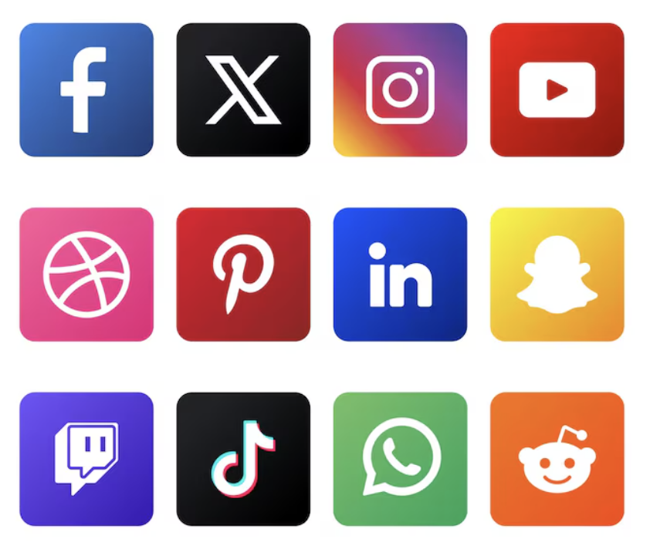
Social Media????
Notes:
In the Q & A have your teacher put in how many of you have any of these accounts.

Slide 3

The Internet?????

Slide 4


Online gaming???
Notes:
Discord–instant messaging and voiceover internet protocol social platform that allows communication through voice calls, video calls, text messaging, and media
–

Slide 5
How many accounts do you have?
1-2
3-4
5-6
7 or more

Slide 6

What do you use various social media, internet and gaming platforms for?
Notes:
"We spend almost half our lives online—gaming, scrolling, and hanging with friends. But how much of what you see is actually real? Between AI deepfakes, professional catfish, and sketchy DMs, the internet is getting weirder. Are you actually 'un-hackable,' or are you just one bad link away from a disaster?"

Slide 7
⚠️ Online Red Flags: How to Spot a Scam
🎣 Phishing & Catfishing (The Fake-Out)
💸 Fraud (The Rip-Off)
🦠 Malware (The Trojan Horse)
🕵️ Privacy Violations (The Data Snatch)
🤖 Deepfakes (The Ai Lie)

Slide 8
🎣 Catfishing: Don’t Get Hooked
The Lowdown: Someone who creates a totally fake identity using stolen photos and a made-up life. They hang out on Discord, TikTok, or in games to build trust and get close to you.
The Goal: They aren't looking for a real friendship. They want to manipulate you for money (gift cards/crypto), get your private secrets, or "sextort" you (using your photos against you).
🚩 If the person you're talking to does these things, hit the block button:
The "Broken Camera" Excuse: They always have a reason why they can't FaceTime or video chat. Their camera is "broken," their "internet is bad," or they are "just too shy."
Too Good to Be True: Their photos look like professional models or influencers. If they look like a 10/10 and their life seems perfect, it’s probably a stolen gallery.
Love Bombing: They move way too fast. They’ll tell you they love you, you're their soulmate, or you're the only one who understands them after only a few days.
The "Secret" Club: They constantly tell you to "keep this just between us" or tell you that your parents/friends wouldn't understand your "special connection."
The Sob Story: They suddenly have a massive emergency—a sick relative, a broken car, or they "need money for a plane ticket" to come see you. They’ll usually ask for payment in gift cards or crypto.
💡 Pro-Tip: The Reverse Image Search
If you’re suspicious, take several of their photos and run them through Google Lens or TinEye. If that "cute girl from the next town over" shows up as a model from a 2023 clothing ad, you know it’s a fake.

Slide 9

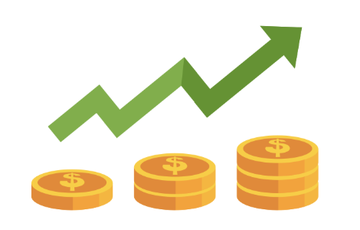

Is it you getting hooked?
Notes:
In 2022, about 30% of U.S. adults reported definitely or probably interacting with a catfish online.
Gender: Men are slightly more likely to report definite interactions than women.
Age & Money: While younger people (18-29) show rising report rates, older victims (70+) suffer much larger financial losses, often over $30,000 per scam, according to allaboutcookies.org and CNN.

Slide 10
🎣 Phishing: Don’t Take the Bait
The Lowdown: Phishing is when a scammer pretends to be someone you trust—like a teacher, a neighbor, a famous gamer, or even "Official Support"—to trick you into clicking a link or giving up your password.
The Goal: They want to hijack your gaming accounts (Roblox, Fortnite, etc.), steal your social media, or get your parents' credit card info.
🚩 Watch out for these signs that a message is fake:
The "Panic" Play: They use scary language like "Your account will be deleted in 1 hour!" or "Suspicious activity detected! Click NOW!" They want you to act before you think.
The "Close Enough" Handle: The email or username looks official but has a tiny typo, like @Instagarm.com or EpicGames-Help@gmail.com. (Big companies don't use Gmail!)
Bad Grammar: The message looks sloppy, has weird spelling, or uses "corporate" or “slang” words that don't quite make sense.
The "Verification" Trap: They send a link to a login page that looks real, but it’s actually a fake site designed to record your password as you type it. Zero sites have verification that are completed this way.
Credit Card Demands: Any "free" game or account setup that requires a credit card "just for age verification" is a massive red flag.
💡 Pro-Tip: Go to the Source
If you get a scary email saying your account is hacked, don't click the link. Instead, close the app/email, go to the official website yourself (e.g., type in Roblox.com), and log in there. If there's a real problem, you'll see a notification in your official dashboard.

Slide 11
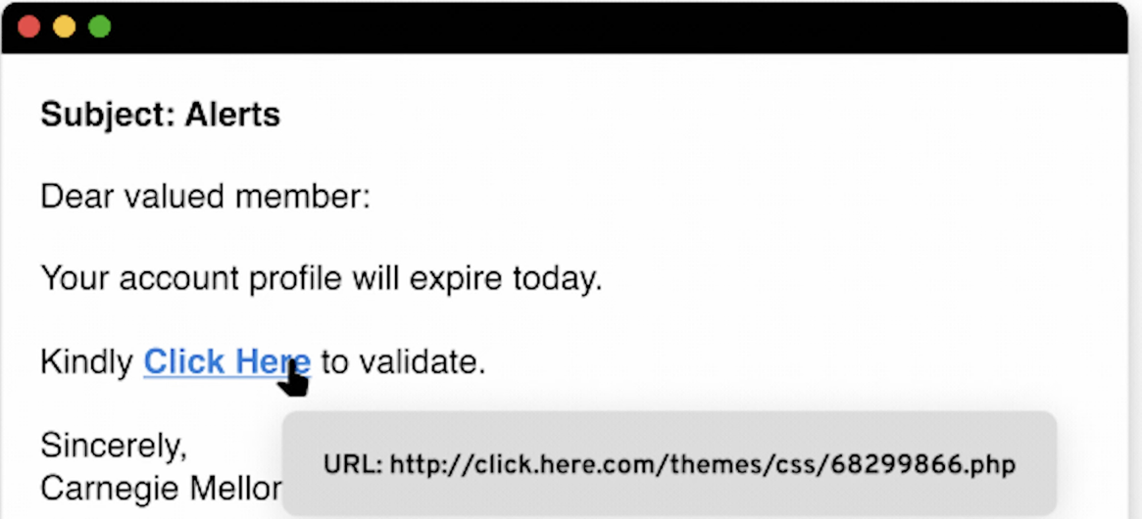
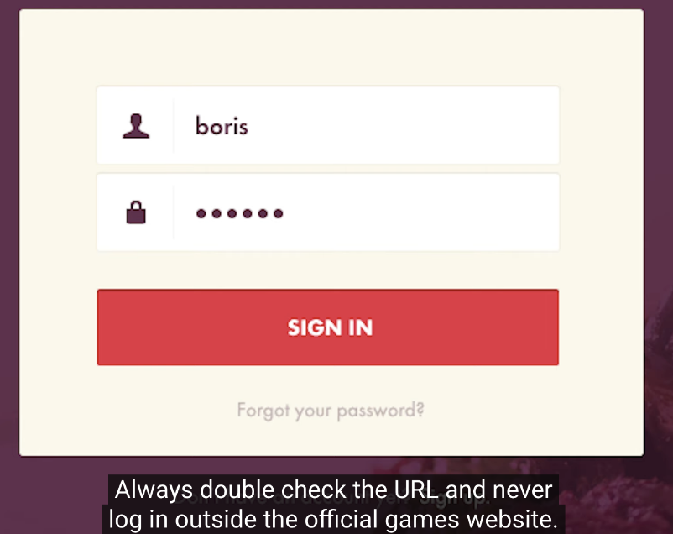
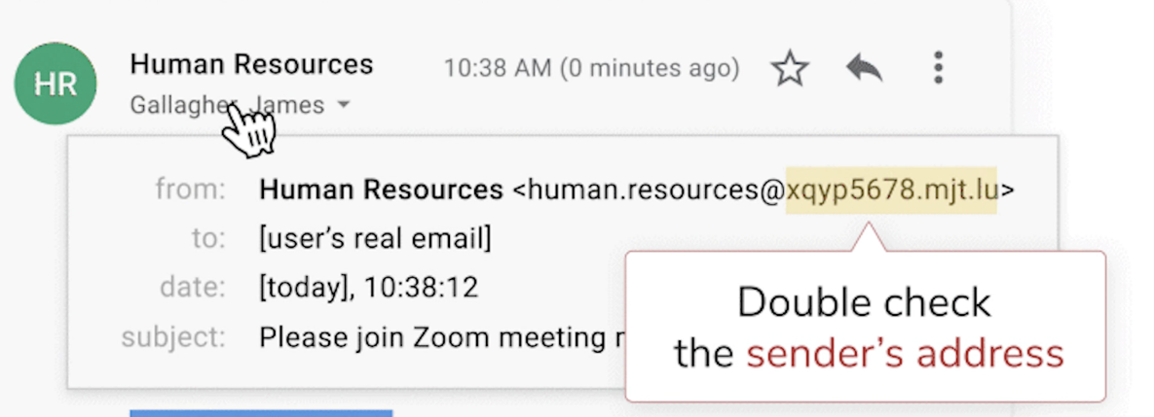
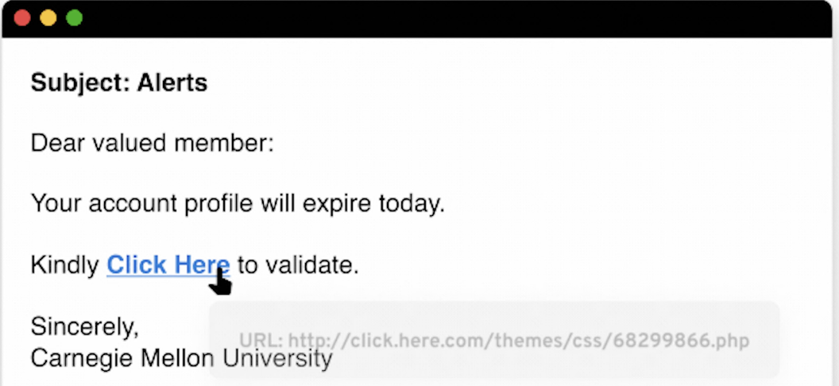

Slide 12
🚩 Fraud & Scams: Don't Get Fooled
The internet is full of "too good to be real" schemes. If it feels like a scam, it probably is.
1. The "Free Stuff" Trap
The Scam: DMs or ads promising free Discord Nitro, V-Bucks, or high-end tech (like an iPhone or PS5) in exchange for "just your info."
The Reality: They aren't sending a prize; they are phishing for your login credentials or selling your data to hackers.
2. AI & Deepfake Scams
The Scam: You see a video of a famous YouTuber or celebrity (like MrBeast) promoting a massive giveaway or a "money-making glitch."
The Reality: It’s an AI-generated deepfake. Scammers use their voices and faces to trick you into downloading malware or sending "verification fees."
3. "Money Mules" & Quick Cash
The Scam: Someone on Snap or Insta asks you to "clear a check" or "receive a transfer" into your Venmo/CashApp, promising you a cut of the money.
The Reality: This is money laundering. Once the bank realizes the money is stolen, you are the one held responsible, and your account gets banned (or worse).
4. Account Takeovers
The Scam: A "friend" DMs you saying they’re locked out of their account and asks you to receive a code for them.
The Reality: That code is actually the password reset code for YOUR account. Once you give it to them, they kick you out and steal your profile.
💡 Pro-Tip: The "Too Good" Rule If an influencer, a "friend," or a random ad offers you something for free that usually costs $100+, it is 100% a scam.
Notes:
Discord Nitro is a real thing-but just because someone wants you to give them money to increase their Nitro doesn’t mean that you need to or should give them money–the request for Nitro is a scam, they can then access your account.
–discord has a live video chat–if you are going to meet up with someone, your parents need to know and you should video call prior to know that who they say they are is who they are.
NO need for card or bank account linked to your discord
Be careful where you get “redeem” codes from

Slide 13

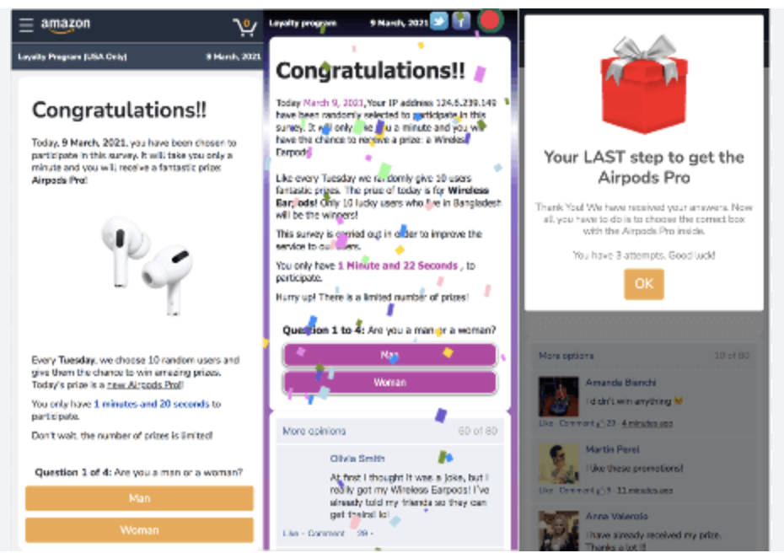
You have NOT won an iphone!!!!!

Slide 14
Malware???? Malwhat????
Think of Malware as a "digital flu" for your phone or computer. The name is just short for Malicious Software.It’s basically code written by hackers to break into your device, mess things up, or spy on you without you ever knowing.
🦠 How Your Device Gets "Sick"
Malware doesn't just show up; it usually tricks you into inviting it in.
The "Freebie" Trap: You download a "free" version of a game, a "cheat" mod, or a cool-looking wallpaper that’s actually a Trojan horse hiding a virus.
The Sus Link: You click a link in a group chat or a sketchy ad that says, "You won!" or "Check out this video of you!"
The "Update" Fake-out: A pop-up tells you your browser is "out of date" and you need to click here to fix it.
🤒 Symptoms to Watch For
If your phone or laptop starts acting weird, it might have caught something:
Battery Drain: Your phone dies way faster than usual because the malware is working hard in the background.
The Snail Pace: Everything is laggy, apps crash for no reason, and your internet feels like it’s stuck in 2005.
Pop-up Party: Random ads start appearing on your home screen or while you’re using apps that shouldn't have ads.
Ghost Messages: Your friends ask why you’re sending them weird links in DMs that you never actually sent.
💊 The "Cure" & Prevention
Stick to the Stores: Only download stuff from the official Apple App Store or Google Play.
Update Everything: Those "Software Update" notifications are like a digital vaccine. They patch the holes hackers use to get in.
Get a Shield: Ask your parents to help you install a solid Antivirus (like a flu shot for your laptop).
When in Doubt, Delete: If an app feels "sus" or you didn't mean to download it, trash it immediately and run a scan.

Slide 15
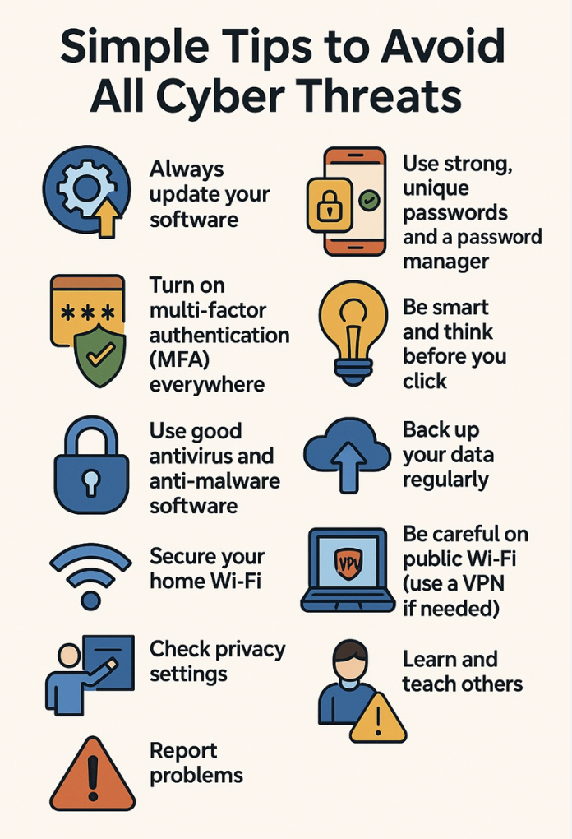

Slide 16
🎭 Deepfakes: Seeing is No Longer Believing
AI can now mimic voices, faces, and handwriting. Just because you see it on video doesn’t mean it actually happened.
What exactly is a Deepfake?
It’s a video, photo, or audio clip created using Artificial Intelligence to make someone look or sound like they’re saying or doing something they never did.
The "New" Scams to Watch For
The "Emergency" Call: You get a voice note or a call from a "friend" or "parent" crying and asking for money because they’re in trouble. Scammers can clone a voice using just a 30-second clip from TikTok.
Fake Celebrity Giveaways: AI-generated videos of streamers or celebs (like Drake or Kai Cenat) telling you to click a link to win a prize.
Non-Consensual Edits: Using AI to put someone’s face onto a different body or into a compromising situation to bully or blackmail them.
How to Spot the "Glitch"
Even the best AI usually leaves "digital fingerprints." Look for:
Unnatural Blinking: The person doesn't blink, or they blink way too much.
"Blurry" Edges: Check the area around the mouth and chin while they talk—does it look fuzzy or glitchy?
The Audio-Sync Lag: Does the voice perfectly match the lip movements? If it feels like a badly dubbed movie, be suspicious.
Check the Source: If a "celeb" is giving away $1M, check their verified official account, not a random "fan page" with 200 followers.
🛡️ The "Safeword" Strategy Pro-Tip: Have a "secret word" with your family or best friends. If you ever get a weird/scary call or DM asking for money or help, ask for the safeword to prove it’s actually them.

Slide 17
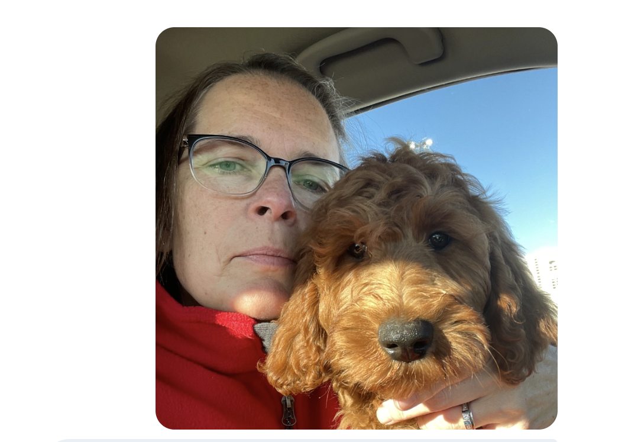
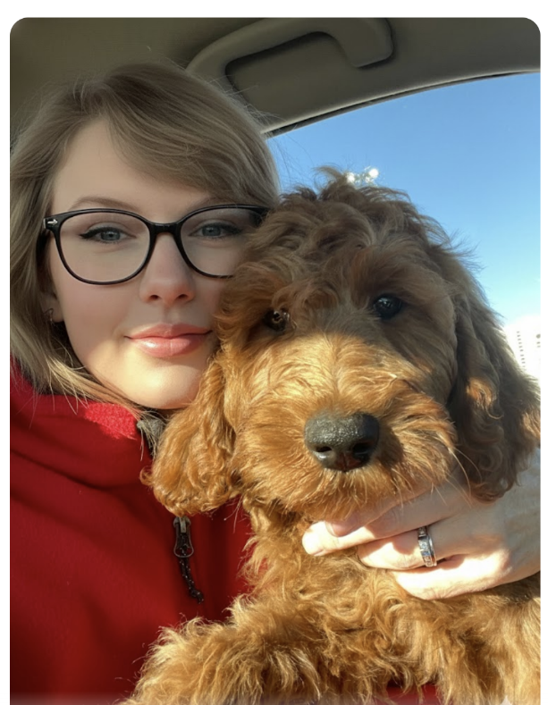



Slide 18
🚩 The "Big 7" Red Flags: How to Spot a Scam
1. The "Ugly" Message (Poor Communication) Real companies have people who check for mistakes. If a message has lots of spelling errors or looks "ugly" and messy, it is probably a trick.
2. The "Don't Tell" Rule (Secretive Requests) If someone online tells you to keep a secret or says, "Don't tell your parents/friends, they won't get it," they are trying to isolate you so you’re easier to manipulate.
3. The Random Slide (Out-of-the-Blue Contact) If a random number or account DMs you with a "check this out" link or a weird attachment you didn't ask for, do not click.
4. The Panic Button (Urgency & Pressure) Scammers say things like "Your account will be deleted in 10 minutes!" or "The police are coming!" They do this so you act fast instead of thinking clearly.
5. The "Too Good" Trap (Too Good to Be True) "You won a $1,000 Amazon card!" or "Free V-Bucks/Skins here!" You didn't win anything. These are just lures to get your login info.
6. Weird Pay Demands (Unusual Payment Methods) Real companies will never ask you to pay them in Gift Cards, Crypto, or Wire Transfers. If someone says they can only take payment via a Steam card or a Venmo "friends and family" transfer, they are robbing you.
7. The Fake Badge (Impersonation) Scammers love to play dress-up. They pretend to be the IRS, your bank, Discord Support, someone your age or even a teacher. Remember: Government agencies will never DM you on Instagram or TikTok or any other social media.
8. The Bot (Robot chatter) Hackers love to program Ai programs to try and scam people. They pretend to be people and build relationships based on what they think you want to hear. Watch for these “canned” responses. Bots are NOT real.
💡 The Golden Rule:
If your gut says it’s "bogus," it probably is. Block, Report, and tell a trusted adult.

Slide 19
🛡️ Your Digital Armor: How to Stay Safe
Be Skeptical (The "Vibe Check"): If someone is moving too fast, acting like your soulmate after two days, or their life seems like a movie script—trust your gut. It’s probably a setup.
Verify (Don't Click): Never trust a link in a DM or email. If "Instagram" says your account is locked, don't click their link. Close the app and go directly to the official website yourself to check.
Protect the Goods: Your passwords, home address, and bank details are for you, not strangers. Treat that info like your phone's passcode—never give it out.
FaceTime or It Didn't Happen: If you've been talking to someone for a while, insist on a video call. If they always have an excuse (camera's broken, bad Wi-Fi), they are 100% faking their identity.
The Power of the Block: You don't owe anyone your time. If someone is being "sus" or making you uncomfortable, block and report them immediately. It’s the fastest way to end the drama.
Keep it Safe: Parents - add something in here

Slide 20
🎭 Conduct: Reputation & Bullying
Permanent Footprint: Comments or photos meant to be "funny" can stay online forever and potentially ruin future college applications.
Cyberbullying: Online interactions can easily turn into cyberbullying or "cancel culture" rabbit holes, which have real-world consequences.
Oversharing: Posting location details (like a gym or school) can allow stalkers to find your physical location.
Outing: Sharing information that you don’t have permission to share.

Slide 21
📱 Digital Safety & "Outing" Online
Being outed online isn't just annoying; it can be dangerous. Here are the main ways people’s privacy gets violated in digital spaces:
1. The "Secret" Screenshot
This is when someone takes a photo or a screenshot of you in a safe space—like a dr. visit, a support group, or even a private Discord—and posts it publicly.
The Risk: It can "out" you to parents, teachers, or bosses before you’re ready to tell them yourself.
2. Edits and "Meme-ing"
Sometimes people use filters, GIFs, or stickers to change your photo and make it look like you’re coming out when you aren’t.
Example: Putting a filter over someone’s photo without asking just to troll them or force them to share information if they aren’t ready. Even if it seems like a "joke," it can have serious consequences.
3. Doxxing & Hate Campaigns
This is the "extreme" side of bullying. It’s when people leak your private info (like your address or real name) to start a wave of harassment.
Real World Impact: In some places, this can even lead to legal trouble. For example, activist Mohamad al-Bokari was outed and arrested simply because of his social media posts.
4. Location Leaks
Checking in at a specific spot or leaving your "Live Location" on can give away where you are.
The Risk: If you’re at a youth center or a specific hangout spot, a "check-in" might accidentally tell everyone on your feed exactly who you’re with and what you’re doing.
Quick Tip: Always ask before you tag a friend in a photo or post their location. You never know who is looking at their feed!
Notes:
Discord also has gift links; might be profile effects
Lots of Bots on discord that will send links into chats and servers

Slide 22
📱 Be Smart. Have Fun!
Tip 1: Use a "Burner" Username - Keep it anonymous to keep hackers and creeps out of your business. A solid screen name protects your privacy and your reputation.
Tip 2: Keep Your Private Life Private - Never post your address, school name, or where you hang out (like your gym or dance studio). Stalkers can use these details to find YOU! And exploit YOU!
Tip 3: The "Billboard Test" - Before you hit send on a photo or video, ask yourself: "Would I be okay with this being on a giant billboard in the middle of town?" Once it's sent, you lose control. It can be screenshotted and shared forever.
Tip 4: Team Up with Adults - Passwords can be a touchy subject, but having a "safety partner" helps if things get weird online. Talk to your parents about how to handle cyberbullies or sketchy DMs so you’re prepared before something happens.
Tip 5: Energy Check (Netiquette) - If you wouldn’t say it to someone’s face (or want it said to someone you love), don't post it. Cyberbullying hurts real people.
Tip 6: Level Up Your Passwords - "123456" isn't a password; it's an invitation. Use a mix of caps, numbers, and symbols. Pro-tip: Use a password manager so you don’t have to remember 50 different complex codes.
Tip 7: Watch Where You Hang Out - Not all chat rooms or forums are safe. Some are full of sketchy people or content you can't unsee. Stick to vetted spaces and keep your setup in a common area of the house so you're not isolated if things get creepy.
Tip 8: Skip the Personal Surveys - If a site or a "quiz" asks for too much private info, bail. Marketers and hackers use that data to track you or target you with scams and malware.
Tip 9: Never Meet Up Solo - People can pretend to be anyone online (even someone your age). Never meet an "online friend" in person without an adult there. If a stranger asks to meet or wants photos, tell a parent immediately.
Tip 10: If it’s Weird, Speak Up - If a DM feels scary, hurtful, or just "off," don't keep it a secret. Use this rule: If the person you’re talking to won't talk to your parents, they aren't someone you should be talking to.
Notes:
Blair Facebook Survey story
Don’t post your house number, street name, etc in your public instagram story, people can easily track you
If you are going on vacation, don’t share your hotel name
Pay attention to has camera on and who doesn’t when on video call
Don’t leave Discord DMs (instagram also) open to everyone–use the security settings to protect yourself.
Don’t connect your other social media accounts to discord to lower your likelihood of having accounts hacked.
Don’t accept invites to channels or threads from people you don’t know because they could be spams and then they will steal your data
Use the block feature–don’t feel bad about blocking or ignoring the profiles that are bothering you
Review settings frequently
You can utilize the accessibility features of the apps to help you navigate the app. It is also important that you communicate with your parents about the social media accounts to help you stay safe and protect you from bad people on the internet.

Slide 23
📱 Level Up Your Digital Game
Staying safe online isn't about following "rules"—it’s about protecting your peace and keeping your digital reputation 100% solid. Here’s how to vibe-check your internet habits:
📺 1. Content: Watch Your Feed
Your "For You" page (FYP) is basically your digital environment. If you’re constantly seeing toxic drama, fake news, or stuff that makes you feel like trash, it’s time to hit that "Not Interested" button. * The Vibe: Don't let the algorithm rot your brain. If the content is sketchy or harmful, scroll past.
👥 2. Contact: Gatekeep Your Circle
Just because someone has a cool profile picture doesn't mean they're legit. In the digital world, "Stranger Danger" is still a thing. * The Rule: If you wouldn't give a random person on the street your home address or phone number, don't give it to a DM. Keep your private life private.
🎭 3. Conduct: Don’t Be a Troll
Screens make it easy to forget there’s a real person on the other side. One "funny" comment can ruin someone’s week—or your future college application.
The Energy: Be the person who keeps it chill. Avoid the "cancel culture" rabbit holes and skip the cyberbullying. Play it smart, not salty.
🛡️ 4. Cybersecurity: Lock It Down
Think of your accounts like your bedroom—you wouldn't want randoms snooping through your stuff.
The Move: Use 2FA (Two-Factor Authentication), stop using "123456" as a password, and don’t click on those "You won an iPhone!" links. Don't get hacked because you were lazy.

Slide 24

Let’s see what you know!
Level 1: The "Urgent" DM
You’re in the middle of class when you get a DM from your friend, Taylor.
Taylor: "OMG, did you see this video of you from the party last night? Everyone is talking about it. Click here to see: bit.ly/aura-leaks-99"
What do you do?
Click the link immediately. You need to know what’s out there.
Message Taylor on a different app. "Hey, did you just send me a weird link?"
Ignore it. It’s probably just Taylor being dramatic.

Slide 25
The Outcome:
Choice 1: Your screen flickers. You’ve just installed a keylogger. (-20 Security)
Choice 2: Taylor replies: "No? I haven't been on my phone all morning. Don't click that!" (+20 Security, +10 Wisdom)
Choice 3: You stay safe for now, but the curiosity eats at you. (Neutral)

Slide 26

Level 2: The "Gamer" Proposition
You’re playing an online battle royale. A player named Viper_X offers to trade you a legendary skin for free because "you're a cracked player." All they need is your login info to "transfer the item."
What do you do?
Give the info. It’s a legendary skin, and they seem nice.
Offer to trade through the official platform. No password sharing.
Report the player. This smells like a scam.

Slide 27
The Outcome:
Choice 1: You lose your account and all your progress. Game over (or restart).
Choice 2: Viper_X goes silent. You saved your account. (+30 Security)
Choice 3: The mods thank you. (+15 Reputation)

Slide 28

Level 3: The Overshare
You just got accepted into your dream summer program. You want to post a photo of the acceptance letter on your story to celebrate.
What do you do?
Post the whole letter. You're proud!
Cover your address and ID number with an emoji.
Post a photo of just the logo and a "Yay!" caption.

Slide 29
The Outcome:
Choice 1: A "fan" uses your address to find out where you live. Creepy. (-50 Privacy)
Choice 2: Better, but some metadata might still be in the photo. (+10 Privacy)
Choice 3: Total pro move. You celebrate without the risk. (+30 Privacy)

Slide 30
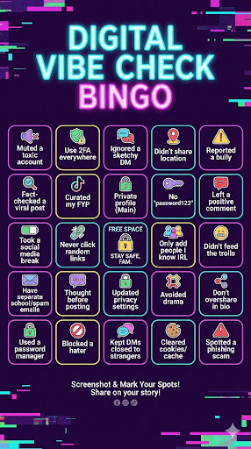
Beat those Bogus Scammers!
Checklist
https://sos.fbi.gov/en/
https://beinternetawesome.withgoogle.com/en_us
Scam or Real: What to do????
Kahoot - Internet Safety

Slide 31
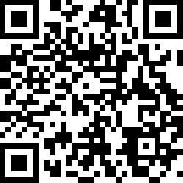
Feedback Survey
https://s.esu10.org/ScamReal

Slide 32
