Slide 1

Disability and the Law: What is my Responsibility?
Michalla Schartz
SE Nebraska Regional Transition Facilitator

Slide 2

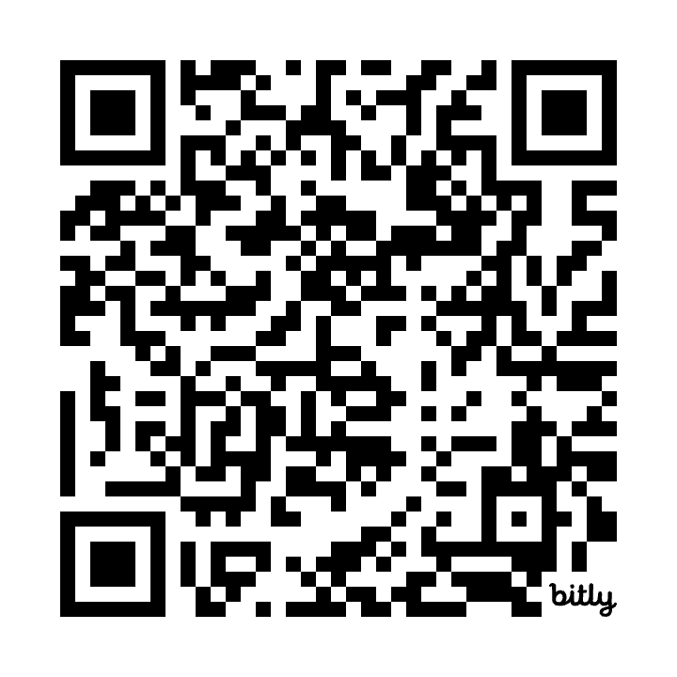
Slide link
Slide link: https://bit.ly/DisabilityCivicLaw
Notes:
What can and should the individual with autism expect during sudden or even expected interactions with law enforcement, customs and immigration employees, first responders such as fire rescue personnel, paramedics, hospital emergency room professionals, or other security professionals?
With few exceptions, law enforcement officers and other first responders will have had little or no training about how to recognize, communicate and respond well when interacting with individuals on the spectrum during field contacts. There may be little understanding of the significance of the words Asperger syndrome, or autism when they hear them.
You can expect a higher level of scrutiny from law enforcement and security personnel when traveling in the 21st century community. Expect public or private scrutiny at:
Airports
Security checkpoints such as government buildings, schools and other secured facilities
Drive-up or walk-up guard shacks
Building entrances
Campuses
Shopping malls or districts
In these days of heightened security? Anywhere!
So what are the best options for the individual during a sudden interaction with a law enforcement officer during an emergency or non-emergency situation? Should you disclose your autism or Asperger Syndrome? When? To whom?
Disclosure tools and options
What's the best tool to use when you decide to disclose your autism or Asperger syndrome to a police officer? Consider using a handout card.
Develop a handout card that can be easily copied and laminated.
Remember that the handout card is replaceable. You can give it away to the officer on the scene.
Carry several at all times.
The handout card can be generic or specific to you.
Work with an autism support organization to develop a generic handout.
Work with persons whose opinions you trust and value to develop a person-specific handout.
What's the best way to tell the officer that you have a handout?
Avoid making sudden movements to reach for the handout card.
Obtain permission or signal your intentions before reaching into your coat or pants pockets, briefcases or bags, or in to glove compartments of vehicles.
Verbally let the officer know that you have autism or Asperger Syndrome and have an information card for them to read. If nonverbal, or if sudden interactions prevent you from speaking, consider using a medical alert bracelet for an officer to read that alerts them to your condition and the fact that you have an information card.
Disclosure to a police officer
The decision to disclose your diagnosis to a police officer will always be yours to make. If you have learned through experience that disclosure would be helpful in a particular situation, you may decide to disclose to a police officer.
Law enforcement officers report that they make their best decisions when they have their best information. A good, strong diagnosis disclosure that includes the use of an information card, contact information for an objective professional, and proof of diagnosis should be considered (Debbaudt, 2006 b).
Plan and practice disclosure techniques
Plan your response and practice with others for a sudden encounter. They will happen to all of us. Careful preparation is your best chance to have a successful interaction with law enforcement.
Discuss these risks with people that you trust.
Develop a hard person-specific disclosure handout.
Develop a personal plan as to how you will use the handout.
Practice through role playing with people you know and trust.
Adapt and amend disclosure handouts. They are only paper. They are not written in stone.
Further suggestions to consider during sudden interactions with police
Do not attempt to flee.
Do not make sudden movements or reach for items.
Try to remain calm.
If you are a victim or are reporting a crime, you may want the police to contact a family member, advocate or friend who can help you through the interview process.
Carry the phone number of an advocacy organization or personal advocate, relative or friend (Debbaudt, 2006 b).
Author Dennis Debbaudt is the parent of a young man who has autism, an author, law enforcement trainer and producer of autism-related videos and curriculum for law enforcement agencies. His materials are in use by law enforcement agencies in the U.S., Canada and the United Kingdom. Dennis can be reached via his website www.autismriskmanagement.com, by email at ddpi@flash.net or by calling 772-398-9756.

Slide 3
Disability and the Law: What is my Responsibility?
While out in the community, people with disabiliites may find themselves in situations in which they need to talk to or deal with law enforcement professionals. These officers need your help to make each experience the most successful it can be for those in the disability community.
As a result, as a member of this community, it is essential to learn how to interact with law enforcement professionals in safe and productive ways.
It is your responsibility to follow the laws of your community, your state and your country. There are also local rules and regulations for businesses and schools you must follow. Having a disability does not mean you do not have to follow the law.
Notes:
What can and should the individual with autism expect during sudden or even expected interactions with law enforcement, customs and immigration employees, first responders such as fire rescue personnel, paramedics, hospital emergency room professionals, or other security professionals?
With few exceptions, law enforcement officers and other first responders will have had little or no training about how to recognize, communicate and respond well when interacting with individuals on the spectrum during field contacts. There may be little understanding of the significance of the words Asperger syndrome, or autism when they hear them.
You can expect a higher level of scrutiny from law enforcement and security personnel when traveling in the 21st century community. Expect public or private scrutiny at:
Airports
Security checkpoints such as government buildings, schools and other secured facilities
Drive-up or walk-up guard shacks
Building entrances
Campuses
Shopping malls or districts
In these days of heightened security? Anywhere!
So what are the best options for the individual during a sudden interaction with a law enforcement officer during an emergency or non-emergency situation? Should you disclose your autism or Asperger Syndrome? When? To whom?
Disclosure tools and options
What's the best tool to use when you decide to disclose your autism or Asperger syndrome to a police officer? Consider using a handout card.
Develop a handout card that can be easily copied and laminated.
Remember that the handout card is replaceable. You can give it away to the officer on the scene.
Carry several at all times.
The handout card can be generic or specific to you.
Work with an autism support organization to develop a generic handout.
Work with persons whose opinions you trust and value to develop a person-specific handout.
What's the best way to tell the officer that you have a handout?
Avoid making sudden movements to reach for the handout card.
Obtain permission or signal your intentions before reaching into your coat or pants pockets, briefcases or bags, or in to glove compartments of vehicles.
Verbally let the officer know that you have autism or Asperger Syndrome and have an information card for them to read. If nonverbal, or if sudden interactions prevent you from speaking, consider using a medical alert bracelet for an officer to read that alerts them to your condition and the fact that you have an information card.
Disclosure to a police officer
The decision to disclose your diagnosis to a police officer will always be yours to make. If you have learned through experience that disclosure would be helpful in a particular situation, you may decide to disclose to a police officer.
Law enforcement officers report that they make their best decisions when they have their best information. A good, strong diagnosis disclosure that includes the use of an information card, contact information for an objective professional, and proof of diagnosis should be considered (Debbaudt, 2006 b).
Plan and practice disclosure techniques
Plan your response and practice with others for a sudden encounter. They will happen to all of us. Careful preparation is your best chance to have a successful interaction with law enforcement.
Discuss these risks with people that you trust.
Develop a hard person-specific disclosure handout.
Develop a personal plan as to how you will use the handout.
Practice through role playing with people you know and trust.
Adapt and amend disclosure handouts. They are only paper. They are not written in stone.
Further suggestions to consider during sudden interactions with police
Do not attempt to flee.
Do not make sudden movements or reach for items.
Try to remain calm.
If you are a victim or are reporting a crime, you may want the police to contact a family member, advocate or friend who can help you through the interview process.
Carry the phone number of an advocacy organization or personal advocate, relative or friend (Debbaudt, 2006 b).
Author Dennis Debbaudt is the parent of a young man who has autism, an author, law enforcement trainer and producer of autism-related videos and curriculum for law enforcement agencies. His materials are in use by law enforcement agencies in the U.S., Canada and the United Kingdom. Dennis can be reached via his website www.autismriskmanagement.com, by email at ddpi@flash.net or by calling 772-398-9756.

Slide 4
What situations to prepare for?
What can and should the individual with disability expect during interactions with
law enforcement,
customs and immigration employees,
first responders such as fire rescue personnel, paramedics, hospital emergency room professionals, or
other security professionals such as TSA, security for concerts or events, others.

Slide 5
Will these professional have training about disabilities?
With few exceptions, law enforcement officers and other first responders will have had little or no training about how to
recognize,
communicate and
respond well
when interacting with individuals with disabilities during field contacts. There may be little understanding of the significance of the words Asperger syndrome, or autism, or intellectual disabilities or to recognize an individual who is deaf or hard of hearing when they encounter them.

Slide 6
When should I expect or look for law enforcement?
You can expect a higher level of scrutiny from law enforcement and security personnel when traveling in the 21st century community. Expect public or private scrutiny at:
Airports
Security checkpoints such as government buildings, schools and other secured facilities
Drive-up or walk-up guard shacks
Building entrances
Campuses
Shopping malls or districts
In these days of heightened security? Anywhere!

Slide 7
What does this all mean?
So what are the best options for the individual during a sudden interaction with a law enforcement officer during an emergency or non-emergency situation?
Should you disclose your disability?
How do I tell someone I have a disability when I am scared or confused?
When do I tell someone?
Who do I tell?
Who can help me?

Slide 8
Here are some ideas!
What's the best tool to use when you decide to disclose your disability to a police officer? Consider using a handout card.
Develop a handout card that can be easily copied and laminated.
Remember that the handout card is replaceable. You can give it away to the officer on the scene.
Carry several at all times.
The handout card can be generic or specific to you.
Work with a support organization to develop a generic handout.
Work with persons whose opinions you trust and value to develop a person-specific handout.

Slide 9
Practice, practice, practice!
Regularly practice different scenarios where your child may interact with the police. Teach your child to stay still, keep their hands visible, and follow simple instructions like “stay here” or “show me your hands.”
Use clear and repetitive role-play to make these actions second nature. Practice in various settings, like home, school, or the park, to make sure your child knows how to react in different environments. This practice can reduce anxiety and improve your child’s ability to follow instructions during an actual encounter.
Teach your child to follow these tips about interacting with law enforcement:
Always show your hands. Never put your hands in pockets or grab for something in a bag.
Stay in place — do not run.
Never attempt to touch or hug a police officer. The same goes for an officer’s dog.
Try not to stand too close to the officer. If you’re not sure about your distance, ask the officer, “Am I standing far enough from you?”
Do your best to tell the officer that you have a disability.
If you don’t understand something, do your best to communicate that to the officer.

Slide 10
Practice, practice, practice!
Regularly practice different scenarios where you interact with the police.
Practice
- staying still (sitting is good!)
- keeping your hands visible (hands on curb, car window or head)
- following simple instructions like “stay here” or “show me your hands.”
- sharing your disability clearly (verbally or by showing a bracelet/card)
- wearing an ID bracelet or necklace to disclose your disablility

Slide 11
What's the best way to tell the officer that you have a handout or ID bracelet?
Avoid making sudden movements
Ask for permission or signal your intentions before reaching into your coat or pants pockets, backpack or bags, or in to glove compartments of vehicles.
Verbally let the officer know that you a disability and have an information card for them to read.
If nonverbal, or if sudden interactions prevent you from speaking, consider using a medical alert bracelet for an officer to read that alerts them to your condition and the fact that you have an information card. It is less threatening to show a bracelet on ankle or wrist then pulling something from a pocket. These tags may also be sewn onto clothing or in other conspicuous places.

Slide 12
Disclosure to a police officer
The decision to disclose your diagnosis to a police officer will always be yours to make. If you have learned through experience that disclosure would be helpful in a particular situation, you may decide to disclose to a police officer.
Introduce yourself
Law enforcement officers report that they make their best decisions when they have their best information. A good, strong diagnosis disclosure that includes the use of an information card, contact information for an objective professional, and proof of diagnosis should be considered (Debbaudt, 2006 b).

Slide 13
Plan and practice disclosure techniques
Plan your response and practice with others for a sudden encounter. They will happen to all of us. Careful preparation is your best chance to have a successful interaction with law enforcement.
Discuss these risks with people that you trust.
Develop a person-specific disclosure handout.
Develop a personal plan as to how you will use the handout.
Practice through role playing with people you know and trust.
Adapt disclosure handouts. They are only paper. They are not written in stone.
Always ask for parent or guardian or advocate before answering questions.

Slide 14
Practice makes perfect
Plan ahead and practice - going through security; contact and ask what will happen and make a social story to prepare for what will happen.
Take a tour to plan for movements or noises that may be unfamiliar to you.
Ask the airport or security if they have a security entrance that is sensory friendly.
Ask the airport, security or police what plan can be in place if a meltdown occurs. Plan for that in case it happens.
Work on the skills you need to be in control. Control is part of adult life. It gives you choices.

Slide 15
Tools to use:
https://alertmebands.com/
https://amberalertgps.com/
Airport Tips
Book - Five is Against the Law (available through the ASD network)
Plan for “Nights Out” to give students time to meet and work with Law Enforcement and other professionals.
Arrange for tours to practice ahead of time.
Register your phone number and address with the local dispatch office to alert professionals to special circumstances.

Slide 16


Certificate of Attendance / Completion!!
Scan this QR Code, click here, or type in this
This will ask 4 Simple Questions:
1. If you are a Student, Teacher or Other
2. The School District you attend or are employed by
3. Your First and Last Name
4. The Email you want the certificate sent to
https://bit.ly/47yB5Lv

Slide 17



