Slide 1
Money Smart for Young People
Grades 6–8

Slide 2
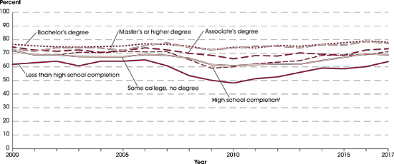
Degrees Matter
2
Source: https://nces.ed.gov/programs/coe/indicator_cba.asp

Slide 3


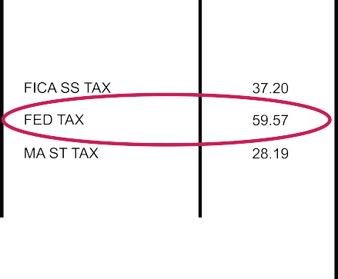





Explaining Taxes
3

Slide 4
Income and Taxes
4
My First Job | My Second Job | My Third Job
Level of Education: Bachelor’s degree | Level of Education: Master’s degree | Level of Education: Master’s degree plus an Advanced Certificate
Job Experience: First month on the job | Job Experience: Five years on the job | Job Experience: 20 years on the job
Salary: $55,000 annually | Salary: $76,000 annually | Salary: $122,000 annually

Slide 5
Tax Brackets
5
If Taxable Income Is: | The Tax Is:
Not over $9,075 | 10% of the taxable income
Over $9,526 but not over $38,700 | $952.50 plus 12% of the excess over $9,525
Over $38,701 but not over $82,500 | $4,453.50 plus 22% of the excess over $38,700
Over $82,501 but not over $157,500 | $14,089.50 plus 24% of the excess over $82,500
Over $157,501 but not over $200,000 | $32,3089.50 plus 32% of the excess over $157,500
Over $200,001 but not over $500,000 | $45,689.50 plus 35% of the excess over $200,000
Over $500,001 | $150,689.50 plus 37% of the excess over $500,000
https://www.irs.com/articles/2018-federal-tax-rates-personal-exemptions-and-standard-deductions

Slide 6








Financial Values Sample
6
Education Charitable Giving
Retirement Family
Investment Entertainment
Travel Lifestyle

Slide 7








Financial Goals Sample
7
Buying my mom a vehicle.
Donating money and volunteering time every holiday season.
Buying a home.
Saving enough money to live a comfortable life.
Buying a gaming system.
Making money by investing in a company’s stock.
Paying for part of my college tuition.
Visiting my relatives out of state.

Slide 8
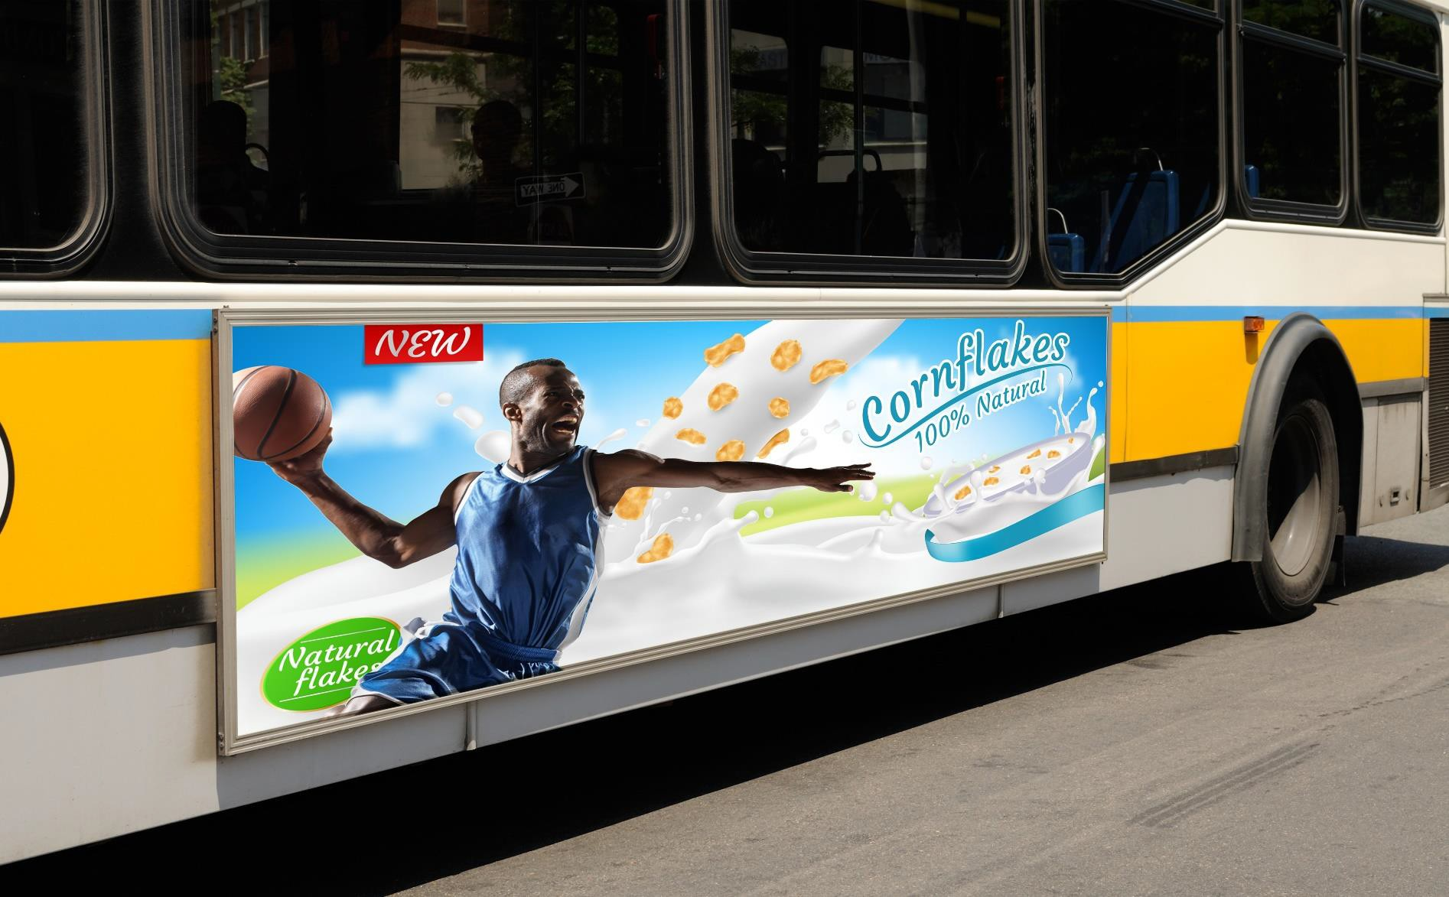
Cereal Advertisement
8

Slide 9

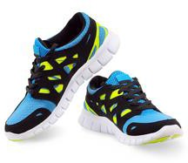














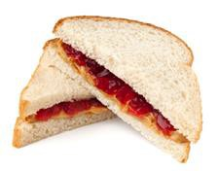
What is Cash Flow?
9

Slide 10
Scenarios
10
Group 1:
Your parents have just informed you that, if you want a car, you’ll have to pay for it yourself. You’re 14, and right now you get a small allowance, but you plan to get a job as soon as you can. In the meantime, you want to make sure that you save money so that you’ll be able to buy your car.
Group 2:
One of your favorite bands is coming to town. Tickets cost $50. All of your friends are going, but you’re not sure you’ll have enough extra money for a ticket. You have two babysitting jobs lined up for the next two weeks, but that leaves you a few dollars short of purchasing the $50 ticket.
Group 3:
You’ve achieved your goal of getting a full scholarship to the college of your dreams. The only problem is that the
scholarship will not cover the cost of textbooks, which you estimate will run you about $500 for the first semester. You have the summer to save money, and you have a summer job.
Group 4:
You like to look very put-together for the start of the new school year. This year, you’re on your own. No one is paying for any of your back-to-school clothes. It’s the summer, and you have a few bucks stashed away in your room, plus a couple of jobs lined up mowing neighbors’ lawns for money.
Group 5:
You want to have a savings fund of $500 for future opportunities. You get some money for holidays and birthdays. You also make about $10 a week selling game guides you created online.

Slide 11



Savings Options
11
Open a Savings Account
Opening a savings account helps you save money. Putting money into a savings account not only sets money aside so that you won’t spend it, but it also gains interest slowly but surely.
Cut Back Cut back on your
spending. Think about the things you need versus the things you want. What can you afford to cut back on and still live a comfortable lifestyle?
Go Cheaper
Of the things that you purchase, are they the least expensive brands? Are you willing to swap brand names with generic brands?
Create New Habits Sometimes, developing new habits can help you save money. Are you willing to change some of your habits in order to save money?
OPTION 1
OPTION 2
OPTION 3

Slide 12
Understanding Compound Interest Warm Up
12
Principal: An amount of money originally invested, excluding any interest or dividends
Interest: Earnings from lending money
Compounding: Calculating interest on both principal and previously earned interest
You have placed $2,000 (called the principal) into a savings account. Your bank offers a generous interest rate of 5%, compounded annually. Using the table below, determine how much money your $2,000 would increase to in five years.
Compound Interest Formula
Year | Balance | Interest | Total
1 | $2,000 | $100 | $2,100
2 | $2,100
3
4
5
𝐴 = 𝑃 1 + ^{𝑟}
𝑛𝑡
𝑛
A = amount of money accumulated after n years, including interest P = principle amount (the initial amount you borrow or deposit)
r = annual rate of interest (as a decimal)
n = number of times the interest is compounded per year
t = number of years the amount is deposited or borrowed for

Slide 13

Investment Vehicles
13
Stock
Investment in a company
Shares of ownership in a company
Value of investment based on
company performance
Mutual Funds
Investments in several areas
(companies, bonds, etc.)
Diversified
Returns are passed to the investors
LAST | CHG | % |  | LAST CHG | % |  | LAST | CHG %
19.01 | 1.2 | 4.4 |  | 14.67 7.8 | 3.7 |  | 34.62 | 1.9 0.3
14.67 | 7.8 | 3.7 |  | 15.01 1.1 | 6.2 |  | 22.65 | 1.9 4.9
12.01 | 1.3 | 2.5 |  | 22.65 1.9 | 4.9 |  | 14.67 | 7.8 3.7
11.04 | 1.6 | 5.3 |  | 18.37 3.2 | 9.5 |  | 12.01 | 1.3 2.5
6.97 | 3.0 | 3.1 |  | 12.01 1.3 | 2.5 |  | 6.97 | 3.0 3.1
22.65 | 1.9 | 4.9 |  | 34.62 1.9 | 0.3 |  | 2.06 | 3.5 2.2
17.07 | 0.6 | 1.2 |  | 12.01 1.3 | 2.5 |  | 34.78 | 5.4 6.7
34.78 | 5.4 | 6.7 |  | 6.97 3.0 | 3.1 |  | 15.01 | 1.1 6.2
15.01 | 1.1 | 6.2 |  | 14.71 2.7 | 2.3 |  | 18.37 | 3.2 9.5
2.06 | 3.5 | 2.2 |  | 18.37 3.2 | 9.5 |  | 19.01 | 1.2 4.4
18.37 | 3.2 | 9.5 |  | 2.06 3.5 | 2.2 |  | 17.07 | 0.6 1.2
14.71 | 2.7 | 2.3 |  | 34.62 1.9 | 0.3 |  | 11.04 | 1.6 5.3
12.01 | 1.3 | 2.5 |  | 18.37 3.2 | 9.5 |  | 14.71 | 2.7 2.3
34.62 | 1.9 | 0.3 |  | 15.01 1.1 | 6.2 |  | 12.01 | 1.3 2.5
Investors pool their money with a Registered Mutual Fund
Returns on the pooled investments
MUTUAL FUND
Mutual Fund — Fund Manager invests this amount with securities

Slide 14



Case Study: Three Stocks
14
Yum! Brands (YUM)
Yum! Brands owns such popular chains as Taco Bell, KFC, and Pizza Hut.
At $73 per share, it sells for 20 times projected earnings, while yielding 2%. The company is expected to increase profits over the next 3–5 years.
Stock symbol: YUM Today’s share price: $73
Target (TGT)
Target has 1,822 stores in the United States that sell everything from baby cribs to bananas. This retailer is expected to increase profits at a 15% pace in coming years.
Shares are $84 each as of October 2018.
Stock symbol: TGT Today’s share price: $84
Walt Disney (DIS)
Walt Disney owns several business interests: animated films, theme parks, and the sports network ESPN, among others. At $116 a share, it is expected to increase profits at a 15% pace for the next several years.
Stock symbol: DIS Today’s share price: $116
Share prices from 10/04/2018
Source: www.nyse.com/index and www.stockmarketgame.org

